Slide 1
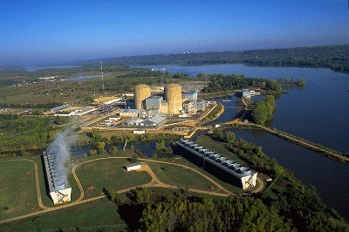

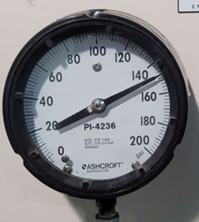
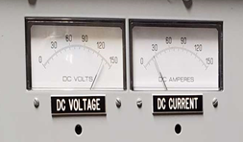
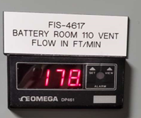

Monticello
Site Survey
June 8-9, 2022

Slide 2
Monticello Site Survey - Summary
702 Points we can read – approximately 50% of Operator Rounds
  377 Gauges with Needles (use Wireless Gauge Reader to read)
    345 standard gauges, standard installation
    10 need to tape needle
    2 need to tape gauge background
    3 with loose or broken glass or hazy lens
    16 are high up – need Ops concurrence to install
    1 is close to pipe – check clearance more carefully
  40 Numeric Displays (use Wireless Digit Reader to read)
  131 Indicator Lights (use Indicator Light WTR to read)
  18 Thermometers (use WHTM as ambient thermometer)
  62 Thermocouples (use modified WTR to read)
  Estimated 80 Calculated Values (values calculated from instrument readings)

Slide 3
Monticello Site Survey - Summary
Points we cannot read:
  Visual check of room/surrounding area
  Requires operator to push button/actuate/test
  Tubes
  Sight glasses
  Controller panels (e.g. air compressor control panel)

Slide 4
Budgetary Quote
NRE to install GBC application on Xcel Windows Server per Nick’s request.
One Year Parts and Labor Warranty Included
Suggest to budget $140,000 per year annual maintenance starting year 2

Slide 5
Background Details

Slide 6
Monticello Site Survey - Summary
702 Points we can read – approximately 50% of Operator Rounds
  377 Gauges with Needles (use Wireless Gauge Reader to read)
    345 standard gauges, standard installation
    10 need to tape needle
    2 need to tape gauge background
    3 with loose or broken glass or hazy lens
    16 are high up – need Ops concurrence to install
    1 is close to pipe – check clearance more carefully
  40 Numeric Displays (use Wireless Digit Reader to read)
  131 Indicator Lights (use Indicator Light WTR to read)
  18 Thermometers (use WHTM as ambient thermometer)
  62 Thermocouples (use modified WTR to read)
  Estimated 80 Calculated Values (values calculated from instrument readings)

Slide 7
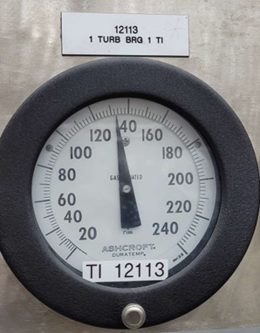
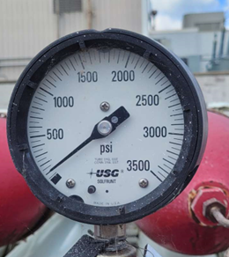
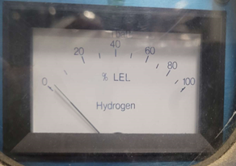
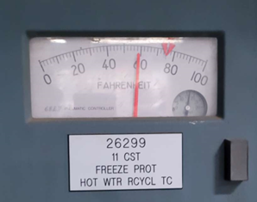
Gauges with Needles - examples

Slide 8
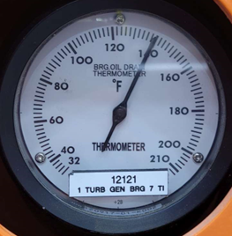
Gauges with Needles – Need to tape tail
Needle same width head and tail
Open glass, taped tail

Slide 9
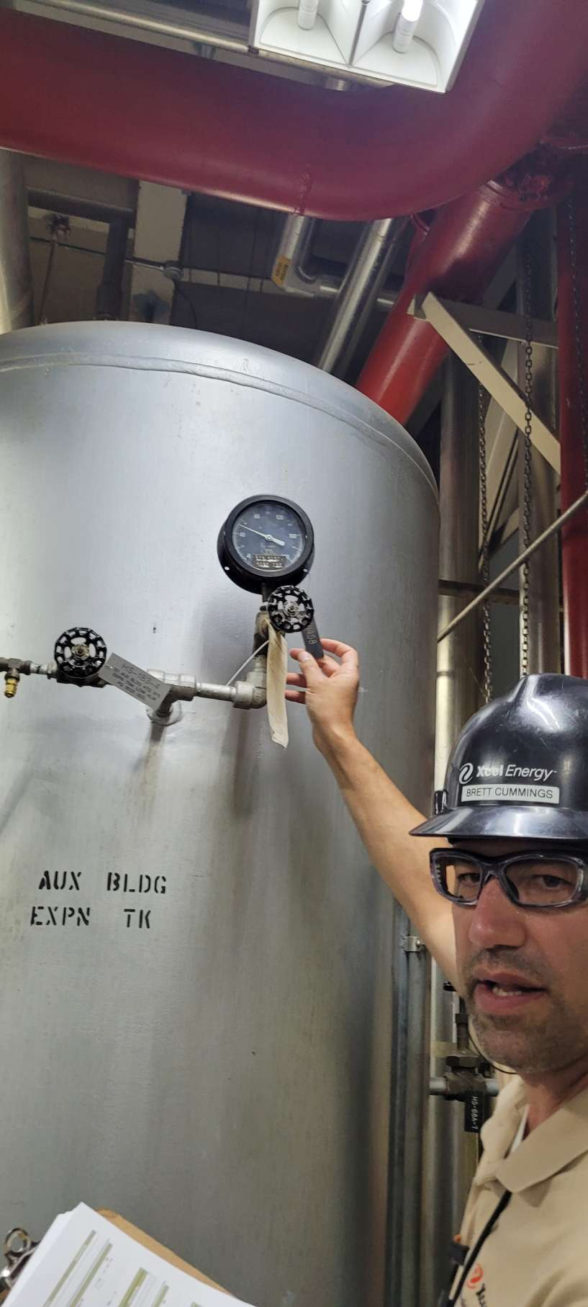
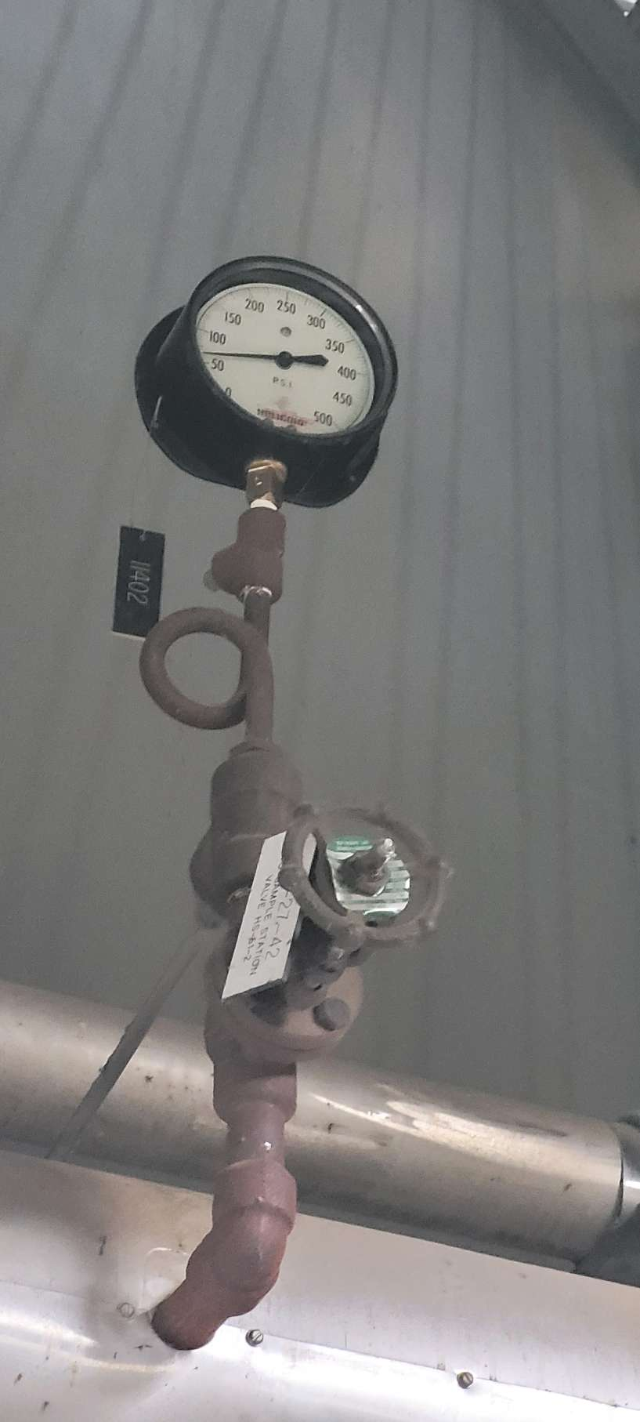
Gauges with Needles – High Location
Check with Ops to see if OK to cover gauge with WGR

Slide 10
Monticello Site Survey - Summary
702 Points we can read – approximately 50% of Operator Rounds
  377 Gauges with Needles (use Wireless Gauge Reader to read)
    345 standard gauges, standard installation
    10 need to tape needle
    2 need to tape gauge background
    3 with loose or broken glass or hazy lens
    16 are high up – need Ops concurrence to install
    1 is close to pipe – check clearance more carefully
  40 Numeric Displays (use Wireless Digit Reader to read)
  131 Indicator Lights (use Indicator Light WTR to read)
  18 Thermometers (use WHTM as ambient thermometer)
  62 Thermocouples (use modified WTR to read)
  Estimated 80 Calculated Values (values calculated from instrument readings)

Slide 11
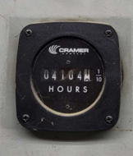
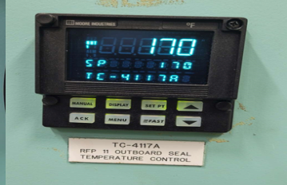
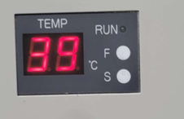
Numeric Displays - examples

Slide 12
Monticello Site Survey - Summary
702 Points we can read – approximately 50% of Operator Rounds
  377 Gauges with Needles (use Wireless Gauge Reader to read)
    345 standard gauges, standard installation
    10 need to tape needle
    2 need to tape gauge background
    3 with loose or broken glass or hazy lens
    16 are high up – need Ops concurrence to install
    1 is close to pipe – check clearance more carefully
  40 Numeric Displays (use Wireless Digit Reader to read)
  131 Indicator Lights (use Indicator Light WTR to read)
  18 Thermometers (use WHTM as ambient thermometer)
  62 Thermocouples (use modified WTR to read)
  Estimated 80 Calculated Values (values calculated from instrument readings)

Slide 13
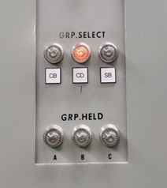
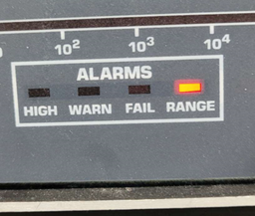
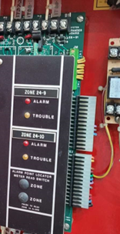
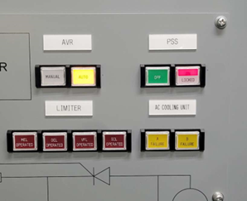
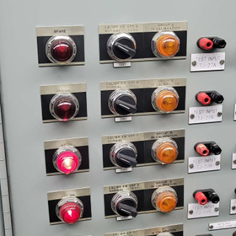
Indicator Lights - examples

Slide 14
Monticello Site Survey - Summary
702 Points we can read – approximately 50% of Operator Rounds
  377 Gauges with Needles (use Wireless Gauge Reader to read)
    345 standard gauges, standard installation
    10 need to tape needle
    2 need to tape gauge background
    3 with loose or broken glass or hazy lens
    16 are high up – need Ops concurrence to install
    1 is close to pipe – check clearance more carefully
  40 Numeric Displays (use Wireless Digit Reader to read)
  131 Indicator Lights (use Indicator Light WTR to read)
  18 Thermometers (use WHTM as ambient thermometer)
  62 Thermocouples (use modified WTR to read)
  Estimated 80 Calculated Values (values calculated from instrument readings)

Slide 15
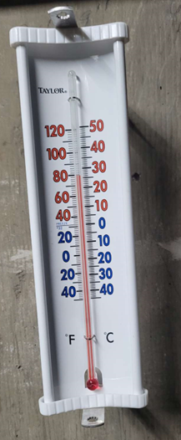
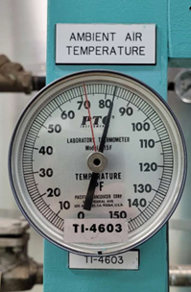
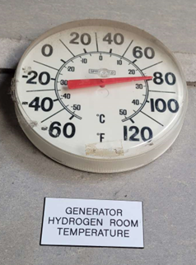
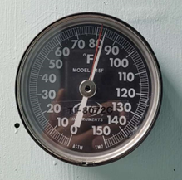
Thermometers - examples

Slide 16
Monticello Site Survey - Summary
702 Points we can read – approximately 50% of Operator Rounds
  377 Gauges with Needles (use Wireless Gauge Reader to read)
    345 standard gauges, standard installation
    10 need to tape needle
    2 need to tape gauge background
    3 with loose or broken glass or hazy lens
    16 are high up – need Ops concurrence to install
    1 is close to pipe – check clearance more carefully
  40 Numeric Displays (use Wireless Digit Reader to read)
  131 Indicator Lights (use Indicator Light WTR to read)
  18 Thermometers (use WHTM as ambient thermometer)
  62 Thermocouples (use modified WTR to read)
  Estimated 80 Calculated Values (values calculated from instrument readings)

Slide 17
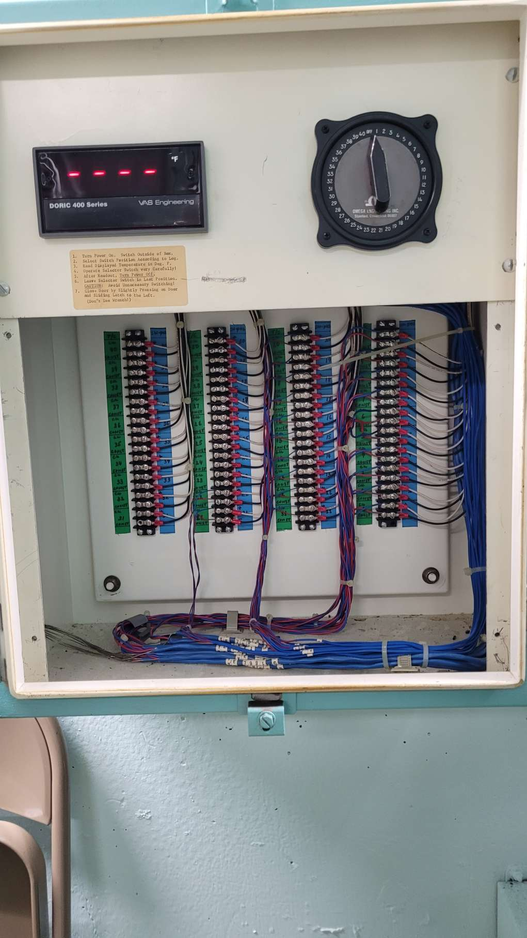
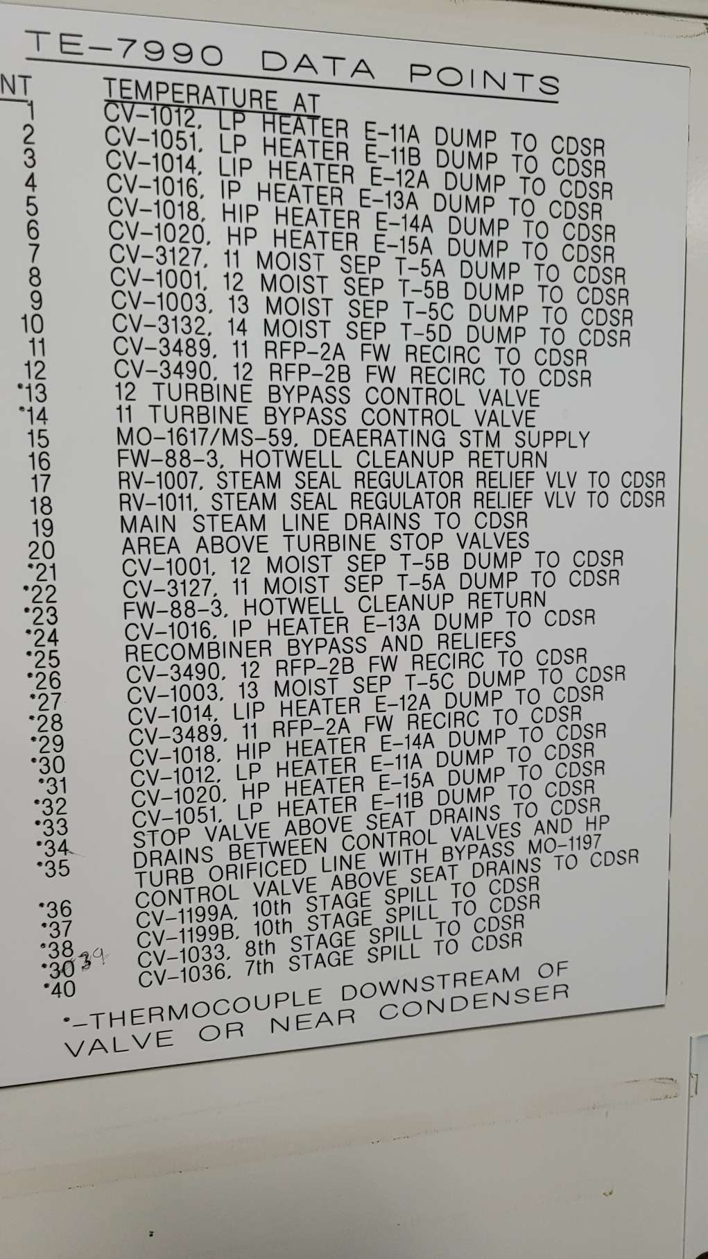
Thermocouples - examples

Slide 18
Detail by Operator Round Sequence
and Instrument

Slide 19
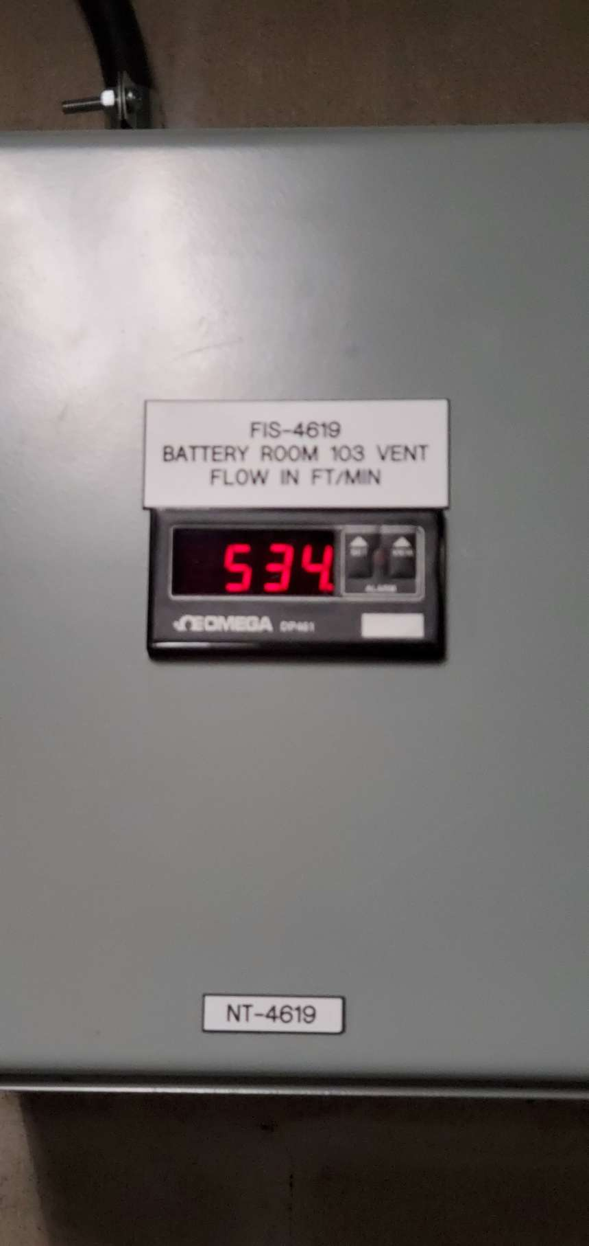
SITE WALK REPORT
Site: Monticello
Seq: 5
Tag: FIS-4619
Type: Digit
Count: 1
Possible: Yes
Comments:
Filename: 20220608_135809.jpg

Slide 20
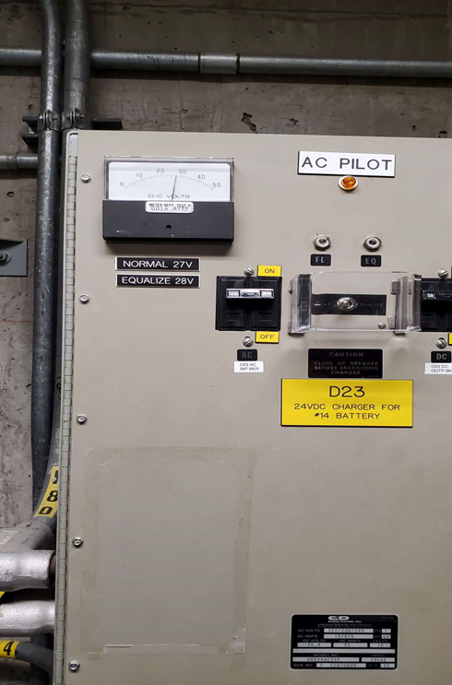
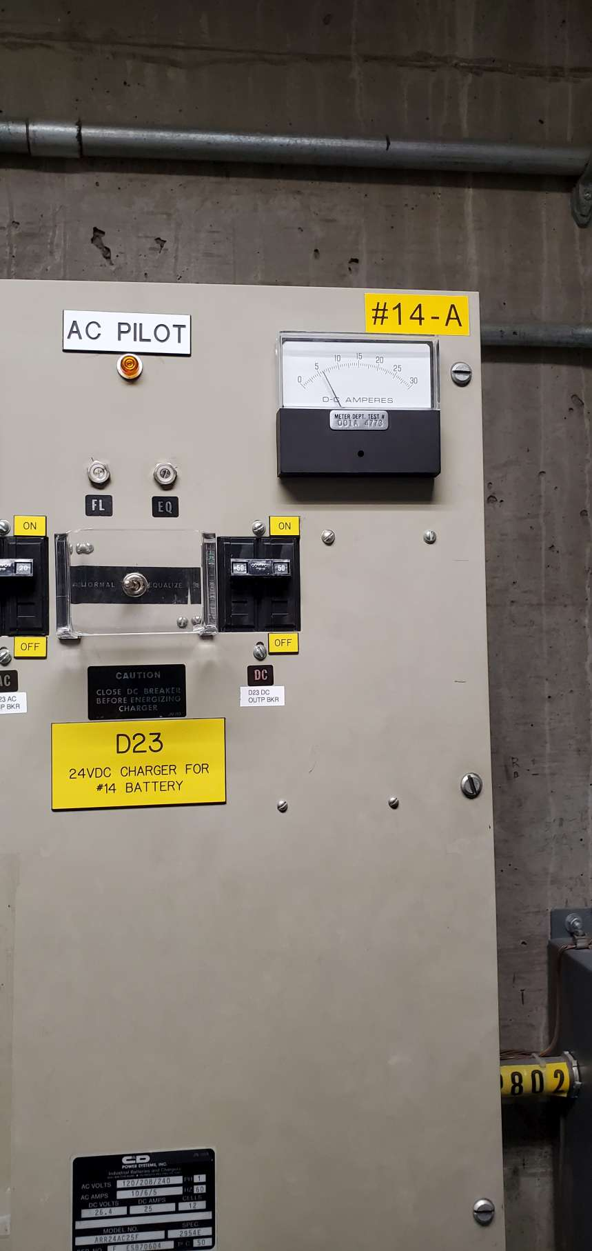
SITE WALK REPORT
Site: Monticello
Seq: 6 & 7
Tag: D23
Type: Gauge
Count: 2
Possible: Yes
Comments:
Filename: 20220608_135842.jpg

Slide 21
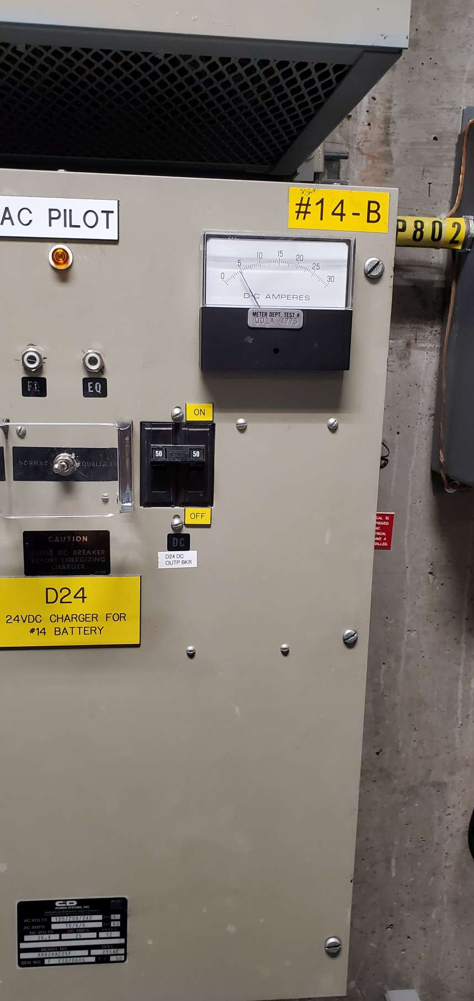
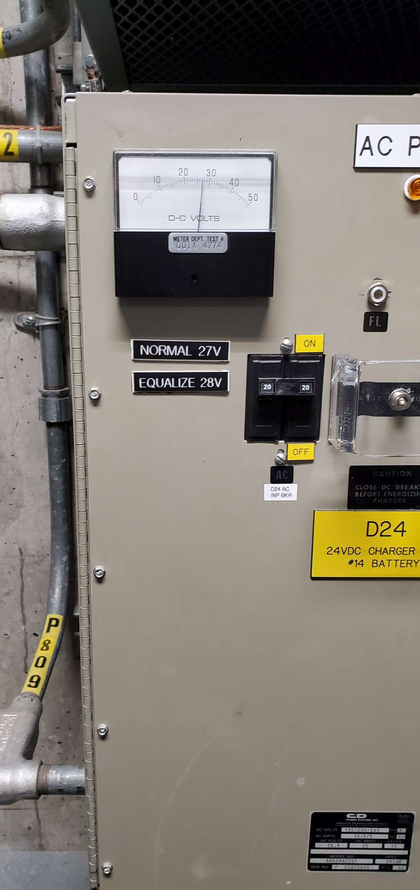
SITE WALK REPORT
Site: Monticello
Seq: 8 & 9
Tag: D24
Type: Gauge
Count: 2
Possible: Yes
Comments:
Filename: 20220608_135852.jpg

Slide 22
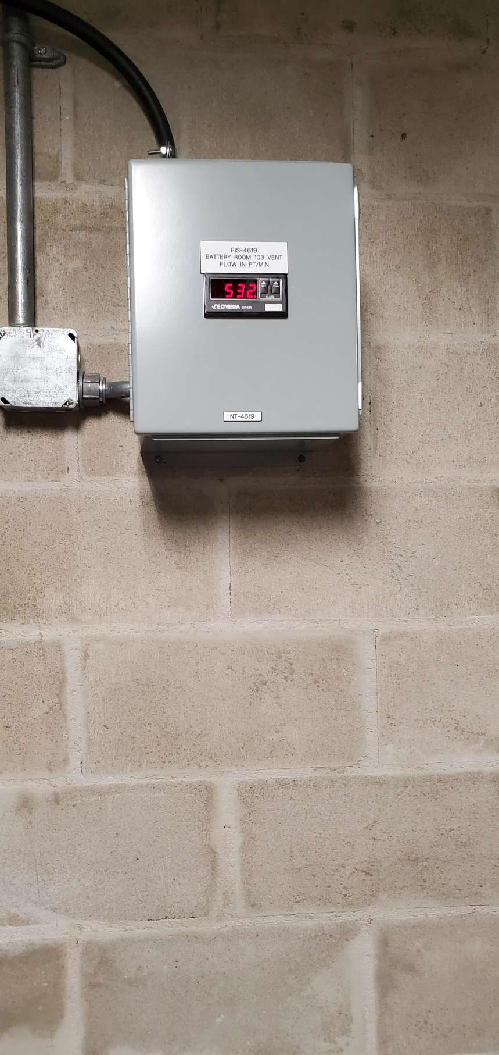
SITE WALK REPORT
Site: Monticello
Seq: 5
Tag: FIS-4619
Type: Digit
Count: 1
Possible: Yes
Comments:
Filename: 20220608_135900.jpg

Slide 23
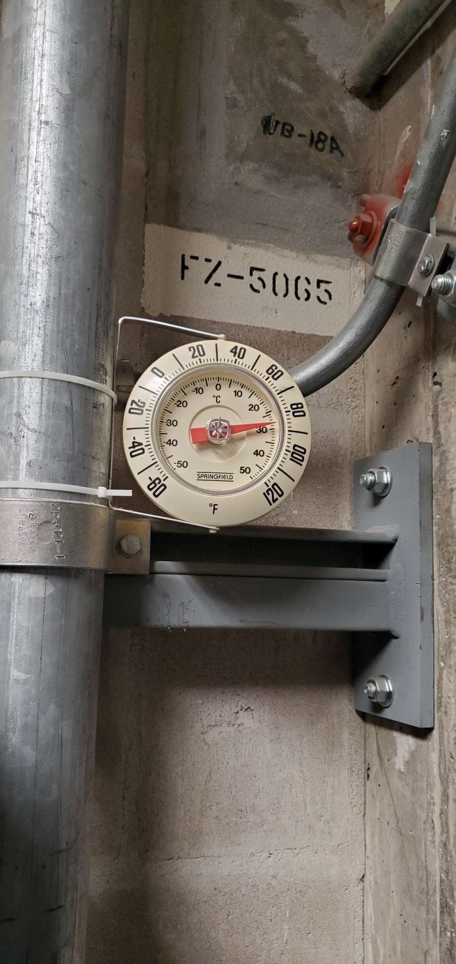
SITE WALK REPORT
Site: Monticello
Seq: 10
Tag: FZ-5065
Type: Thermometer
Count: 1
Possible: Yes
Comments: WHTM
Filename: 20220608_135956.jpg

Slide 24
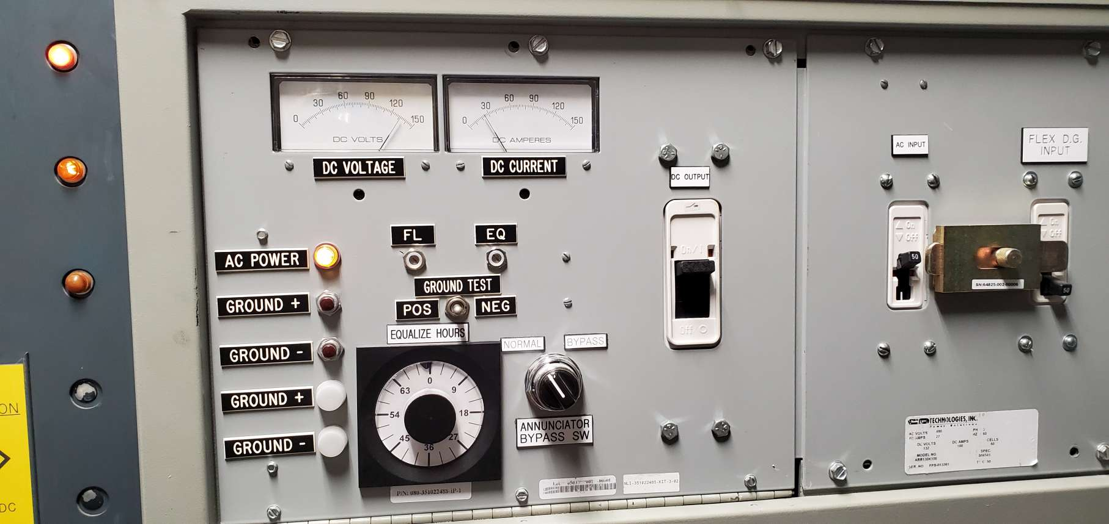
SITE WALK REPORT
Site: Monticello
Seq: 12 & 13
Tag: D20
Type: Gauge
Count: 2
Possible: Yes
Comments:
Filename: 20220608_140148.jpg

Slide 25
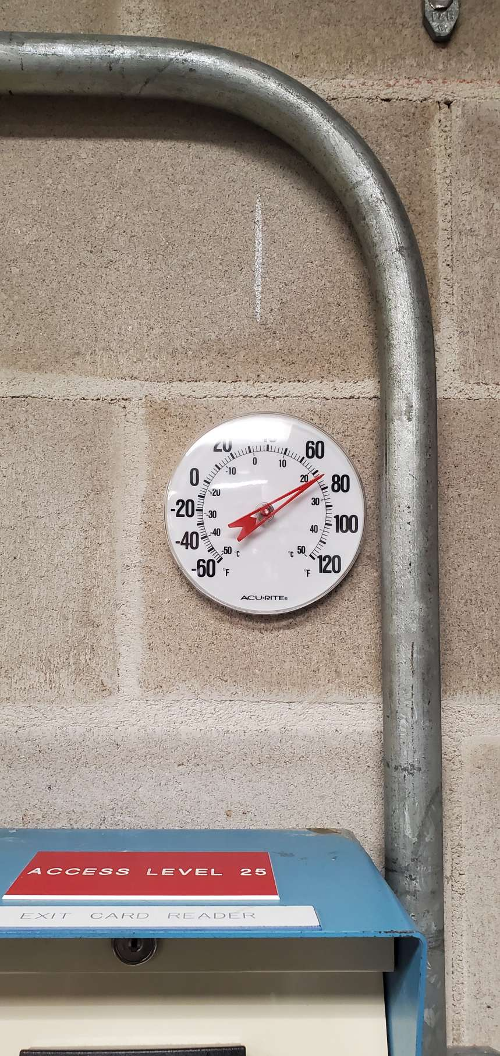
SITE WALK REPORT
Site: Monticello
Seq: 23
Tag:
Type: Thermometer
Count: 1
Possible: Yes
Comments: WHTM
Filename: 20220608_140610.jpg

Slide 26
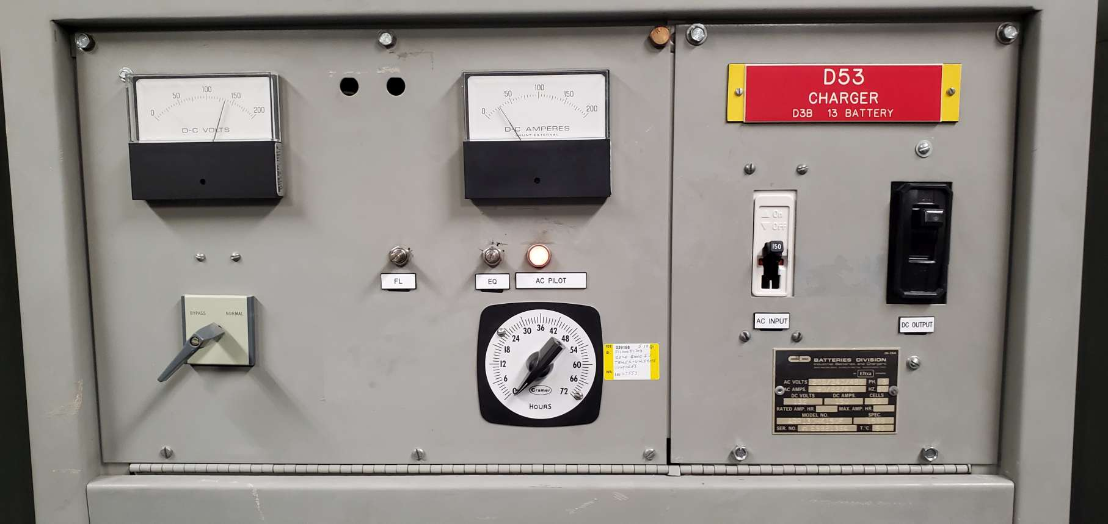
SITE WALK REPORT
Site: Monticello
Seq: 28,29
Tag: D53
Type: Charger
Count: 2
Possible: Yes
Comments:
Filename: 20220608_140740.jpg

Slide 27
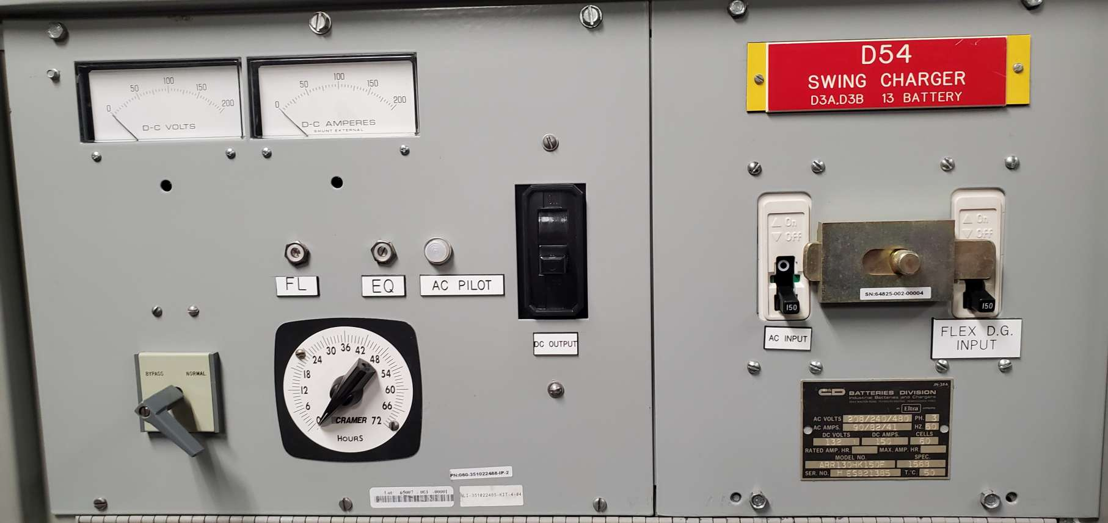
SITE WALK REPORT
Site: Monticello
Seq: 30 & 31
Tag: D54
Type: Gauge
Count: 2
Possible: Yes
Comments:
Filename: 20220608_140746.jpg

Slide 28
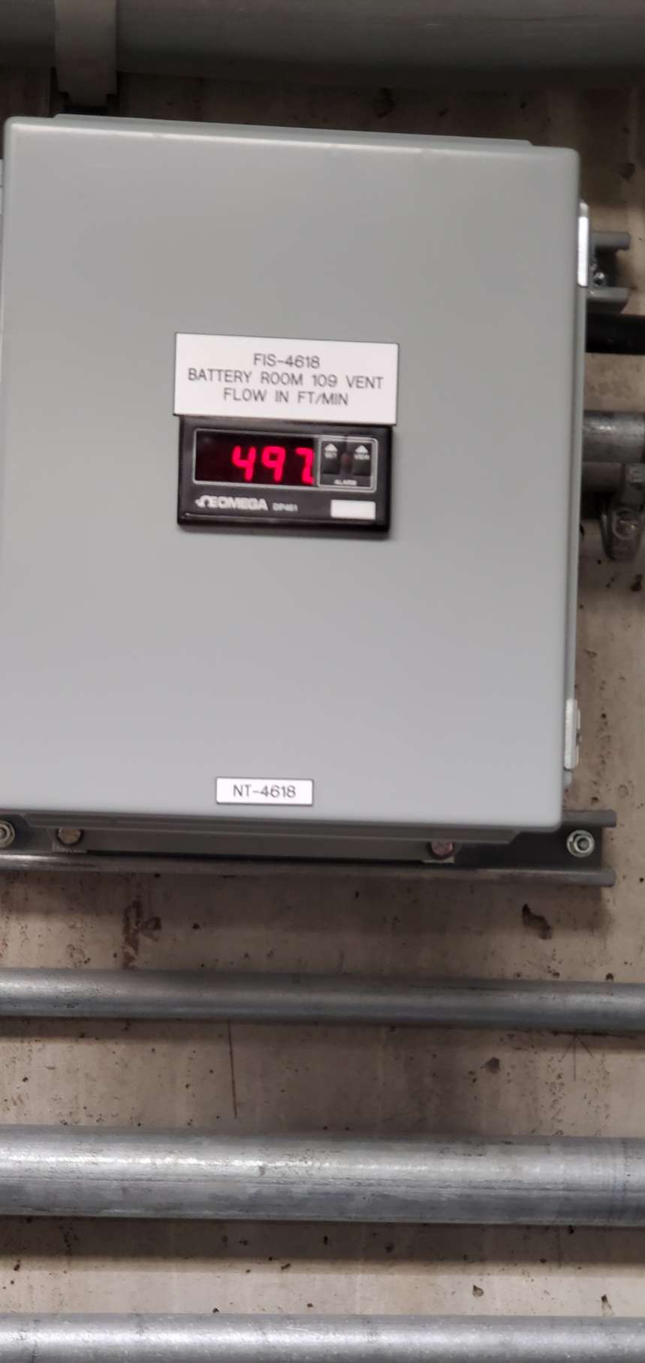
SITE WALK REPORT
Site: Monticello
Seq: 33
Tag: FIS-4618
Type: Digit
Count: 1
Possible: Yes
Comments:
Filename: 20220608_140829.jpg

Slide 29
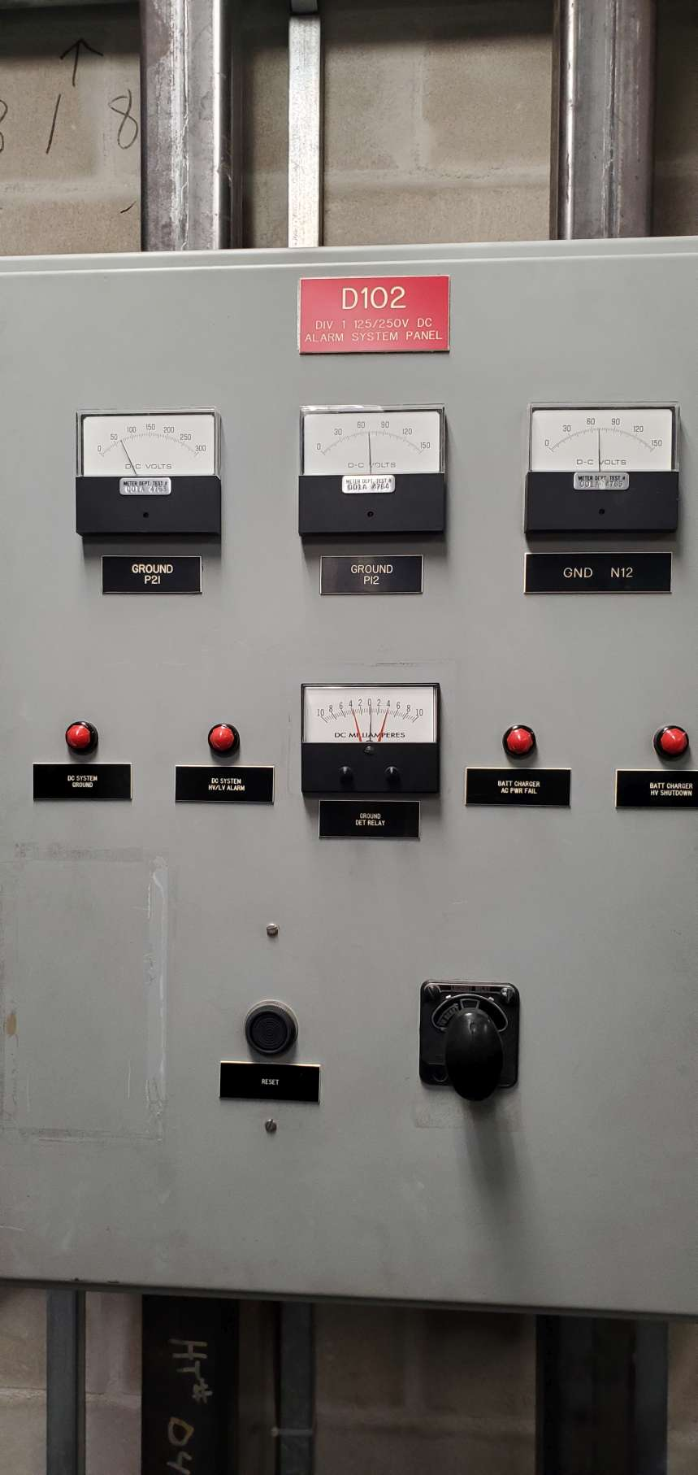
SITE WALK REPORT
Site: Monticello
Seq: 32
Tag: D-102 GND DET RElAY
Type: Gauge
Count: 1
Possible: Yes
Comments:
Filename: 20220608_140858.jpg

Slide 30
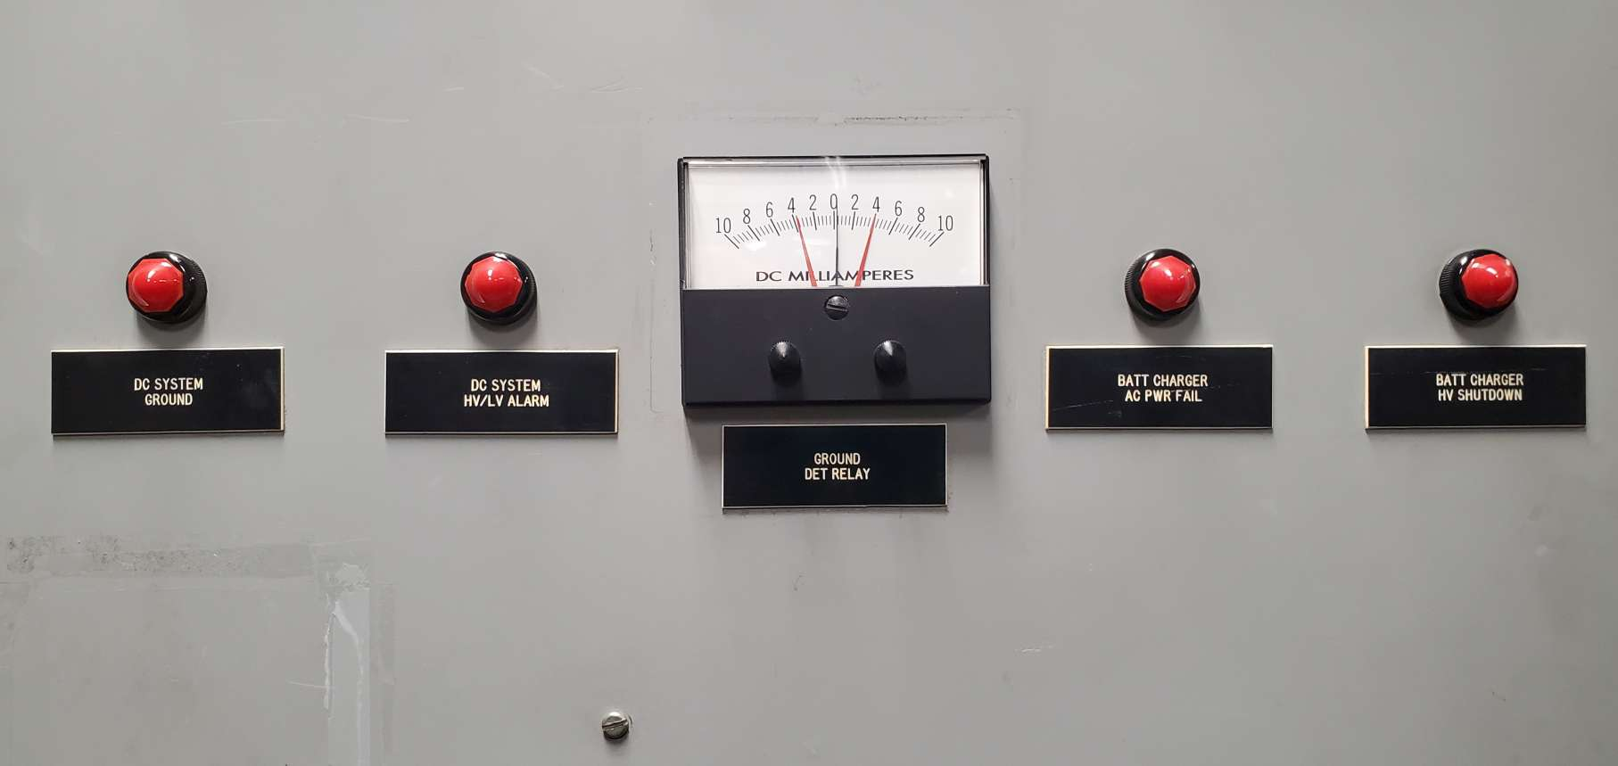
SITE WALK REPORT
Site: Monticello
Seq: 34
Tag: D-102
Type: Light
Count: 4
Possible: Yes
Comments:
Filename: 20220608_141020.jpg

Slide 31
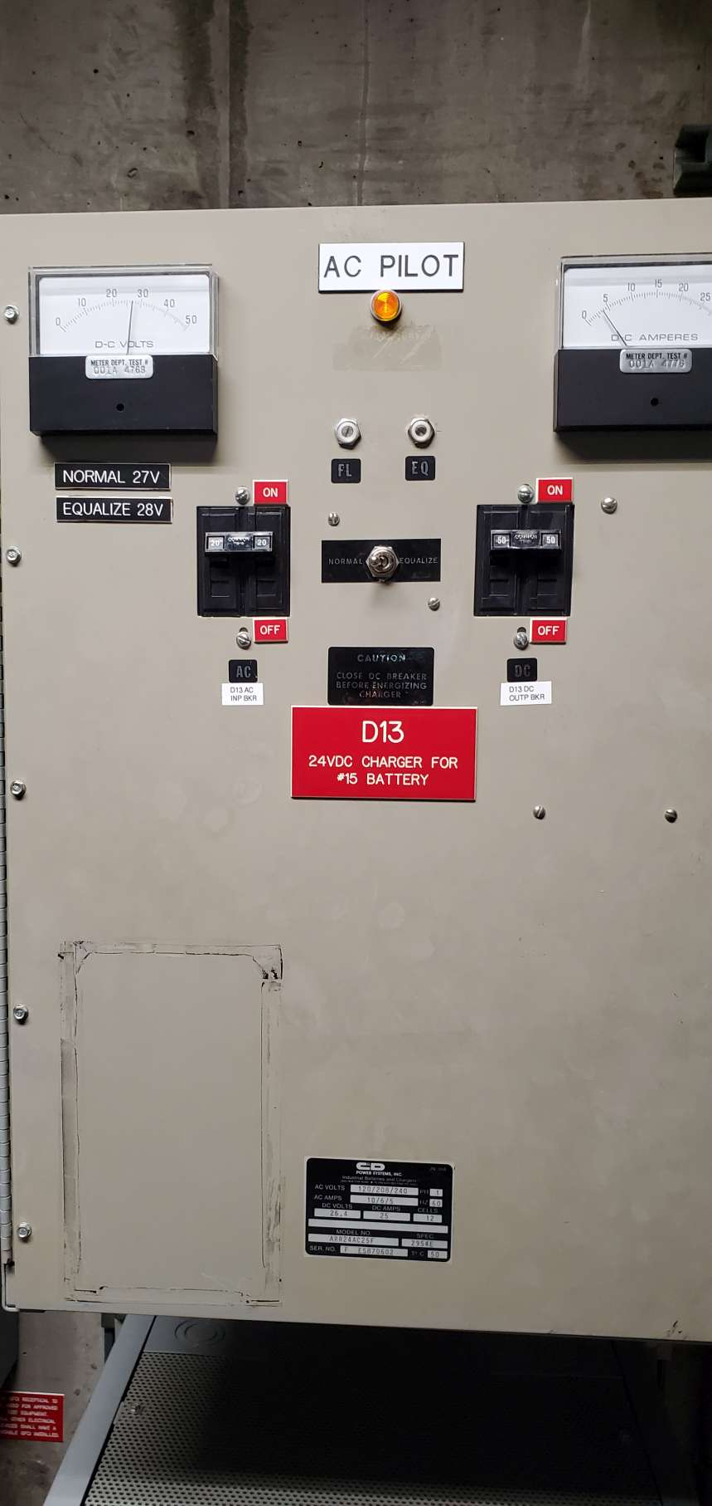
SITE WALK REPORT
Site: Monticello
Seq: 35 & 36
Tag: D13
Type: Gauge
Count: 2
Possible: Yes
Comments:
Filename: 20220608_141136.jpg

Slide 32
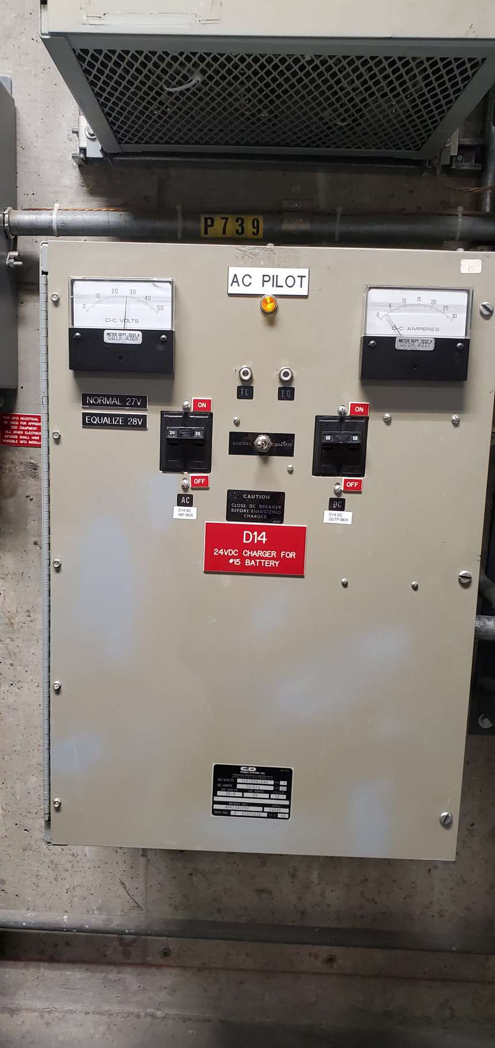
SITE WALK REPORT
Site: Monticello
Seq: 37 & 38
Tag: D14
Type: Gauge
Count: 2
Possible: Yes
Comments:
Filename: 20220608_141149.jpg

Slide 33
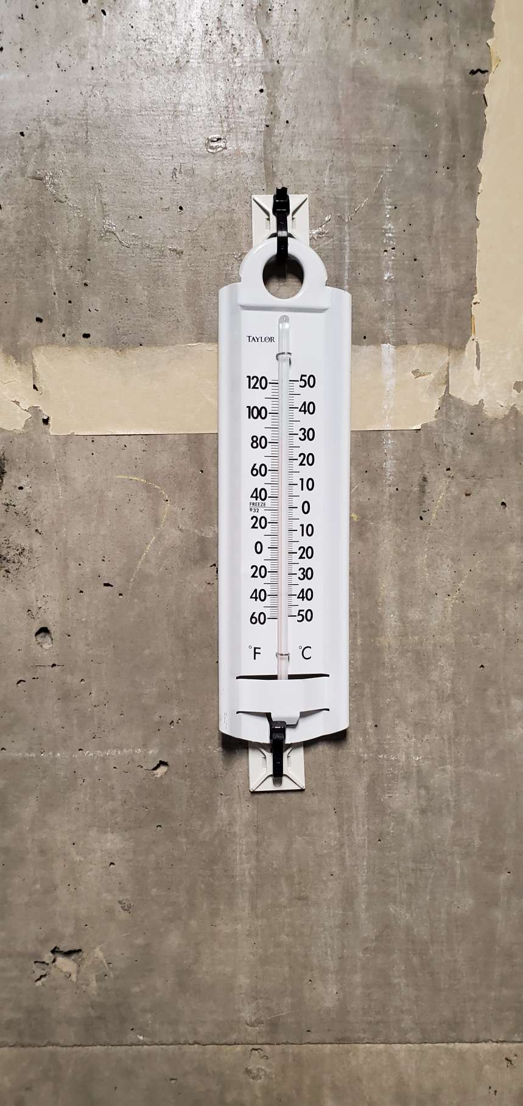
SITE WALK REPORT
Site: Monticello
Seq: 39
Tag:
Type: Thermometer
Count: 1
Possible: Yes
Comments: WHTM
Filename: 20220608_141237.jpg

Slide 34
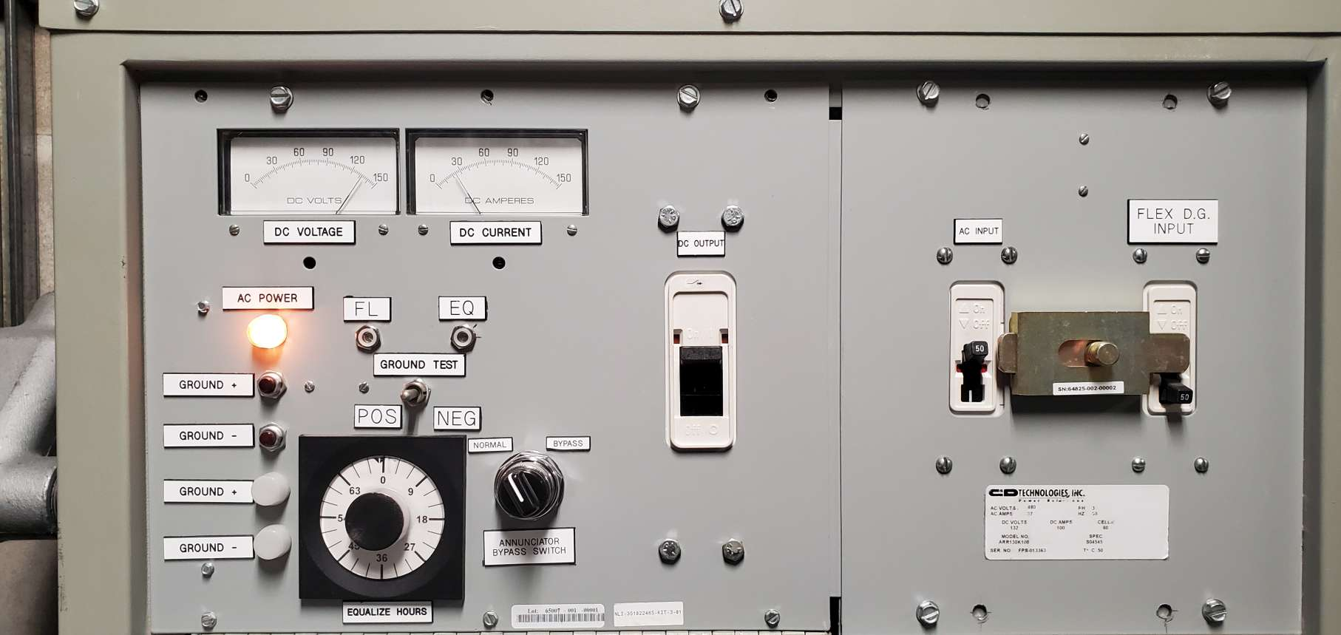
SITE WALK REPORT
Site: Monticello
Seq: 41 & 42
Tag: D-10
Type: Gauge
Count: 2
Possible: Yes
Comments:
Filename: 20220608_141323.jpg

Slide 35
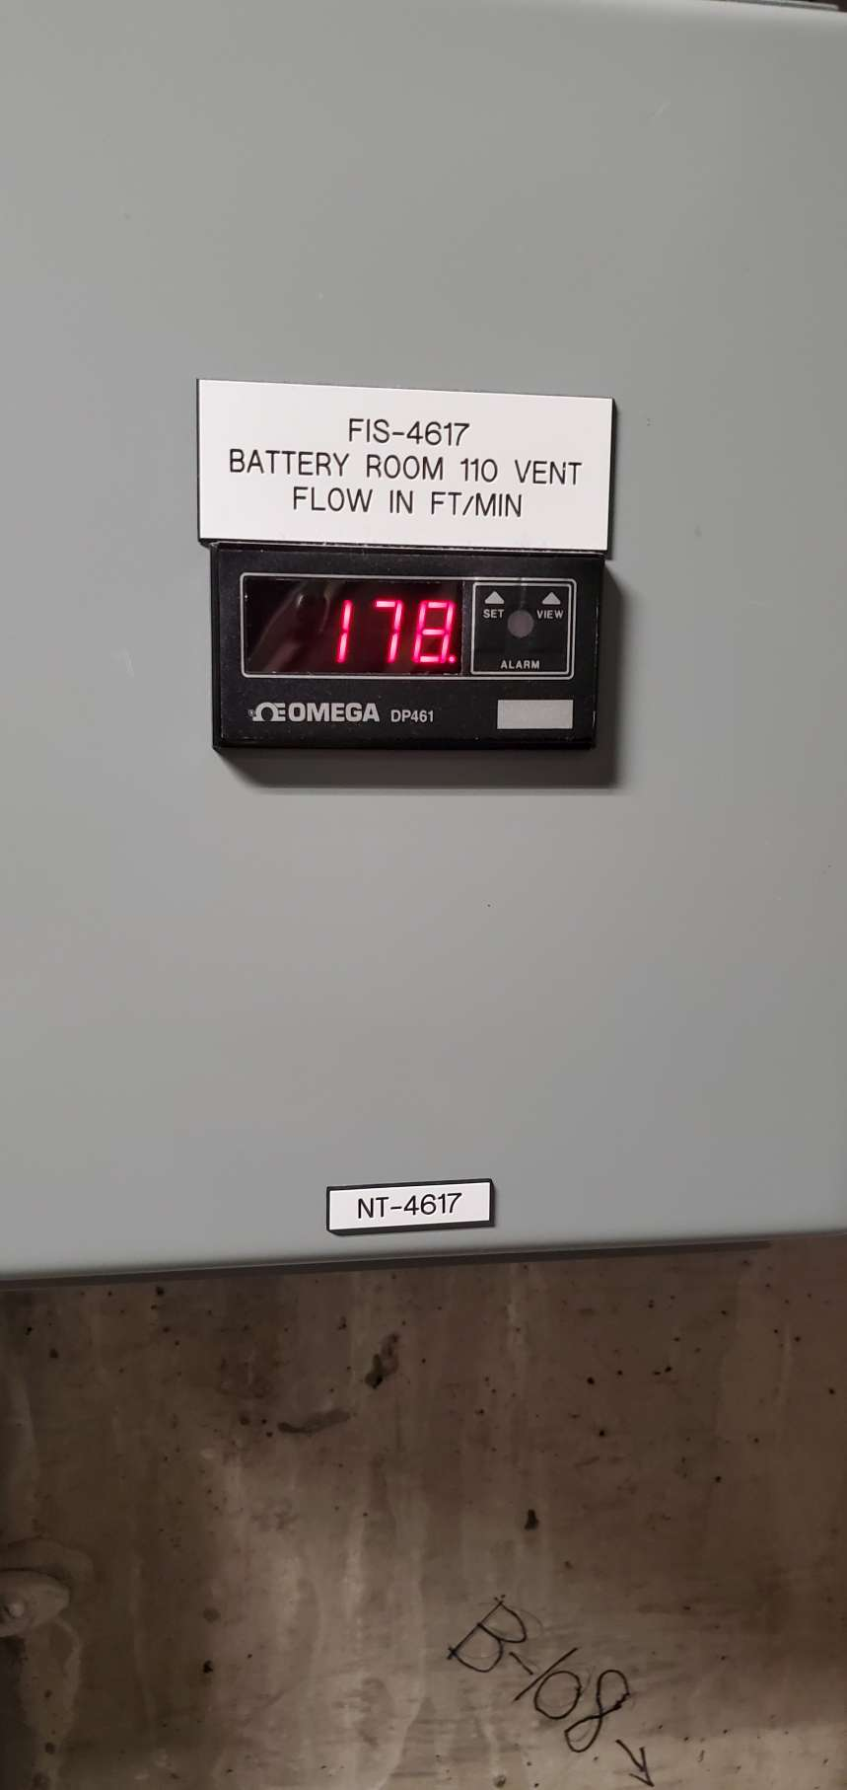
SITE WALK REPORT
Site: Monticello
Seq: 46
Tag: FIS-4617
Type: Digit
Count: 1
Possible: Yes
Comments:
Filename: 20220608_141337.jpg

Slide 36
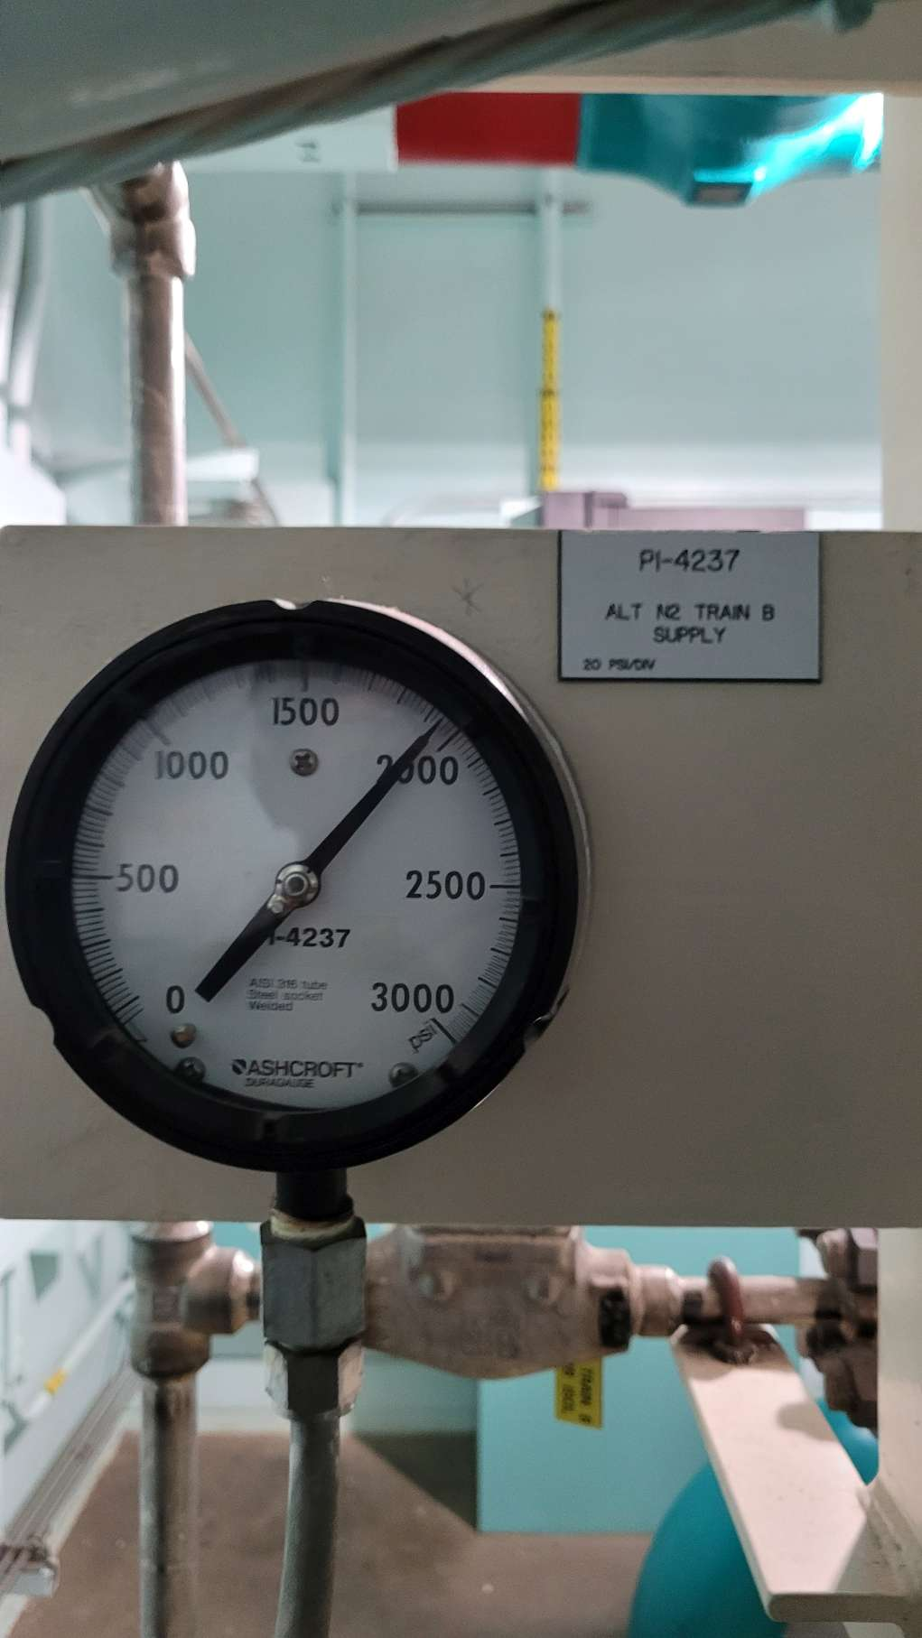
SITE WALK REPORT
Site: Monticello
Seq: 49
Tag: PI-4237
Type: Gauge
Count: 1
Possible: Yes
Comments:
Filename: 20220608_144536.jpg

Slide 37
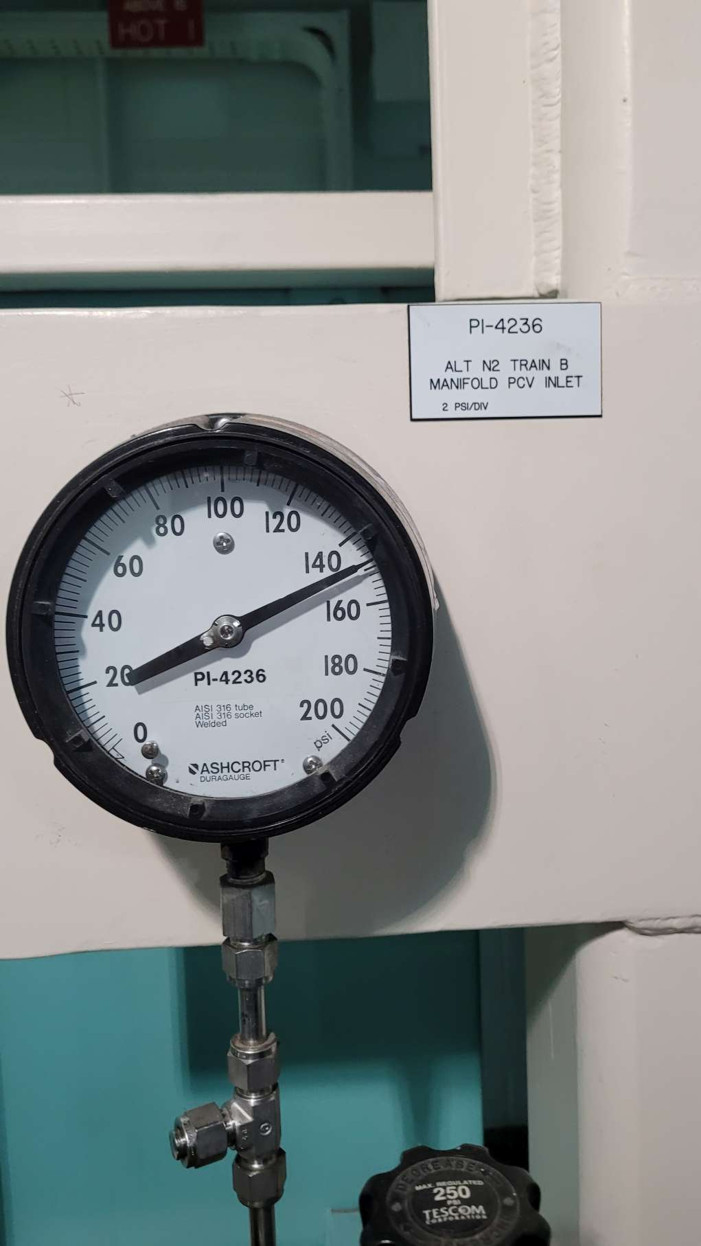
SITE WALK REPORT
Site: Monticello
Seq: 51
Tag: PI-4236
Type: Gauge
Count: 1
Possible: Yes
Comments:
Filename: 20220608_144626.jpg

Slide 38
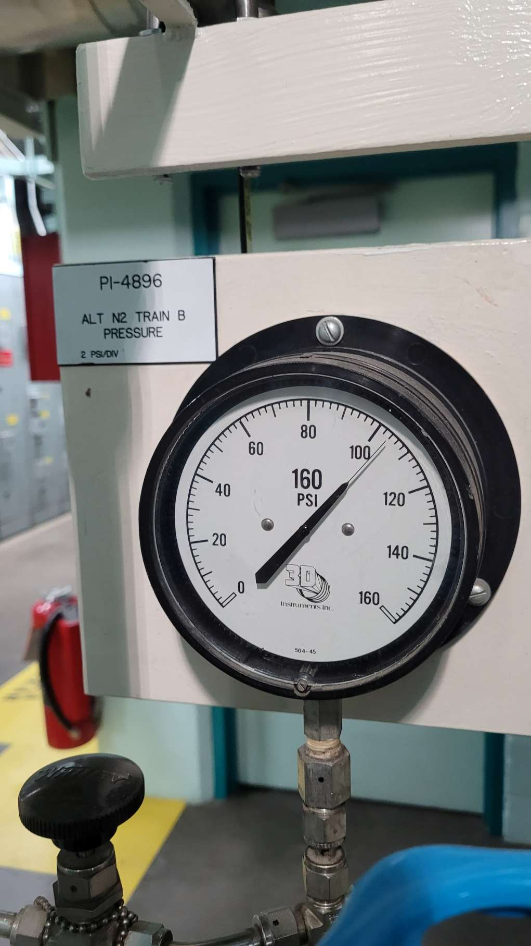
SITE WALK REPORT
Site: Monticello
Seq: 52
Tag: PI-4896
Type: Gauge
Count: 1
Possible: Yes
Comments:
Filename: 20220608_144631.jpg

Slide 39
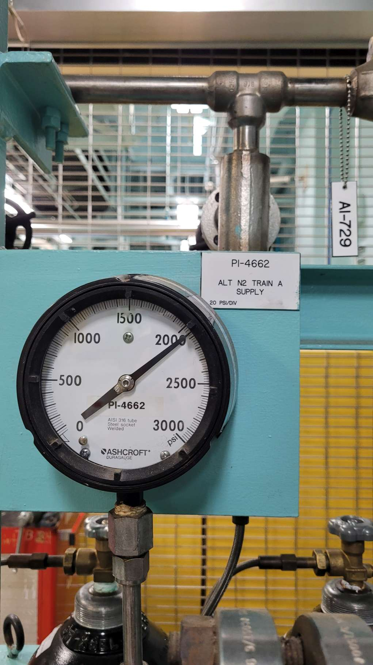
SITE WALK REPORT
Site: Monticello
Seq: 54
Tag: PI-4662
Type: Gauge
Count: 1
Possible: Yes
Comments:
Filename: 20220608_144828.jpg

Slide 40
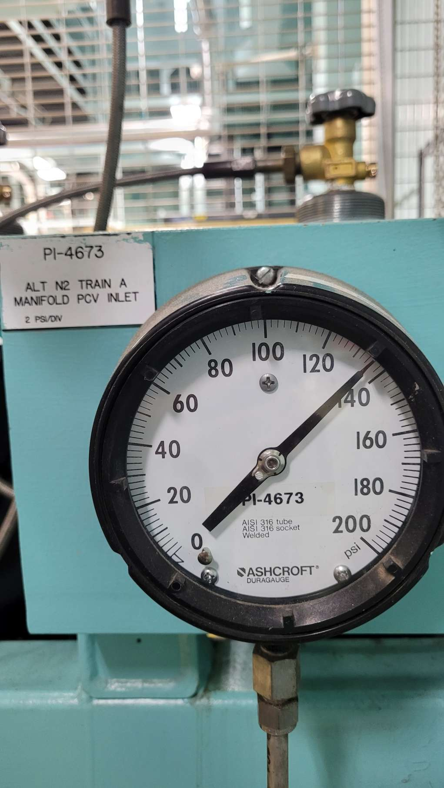
SITE WALK REPORT
Site: Monticello
Seq: 56
Tag: PI-4673
Type: Gauge
Count: 1
Possible: Yes
Comments:
Filename: 20220608_144833.jpg

Slide 41
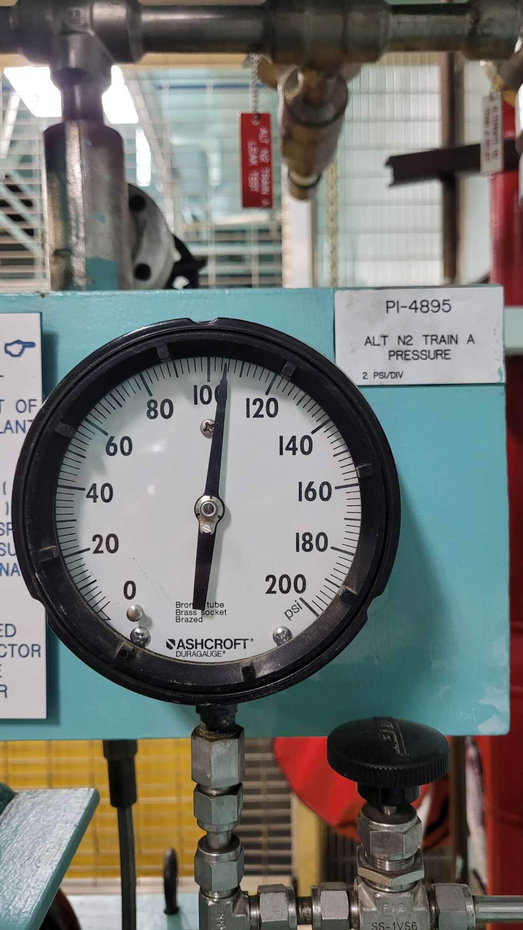
SITE WALK REPORT
Site: Monticello
Seq: 57
Tag: PI-4895
Type: Gauge
Count: 1
Possible: Yes
Comments:
Filename: 20220608_144837.jpg

Slide 42

SITE WALK REPORT
Site: Monticello
Seq: 59
Tag: PI-4840
Type: Gauge
Count: 1
Possible: Yes
Comments:
Filename: 20220608_145000.jpg

Slide 43

SITE WALK REPORT
Site: Monticello
Seq: 60
Tag: PI-4843
Type: Gauge
Count: 1
Possible: Yes
Comments:
Filename: 20220608_145004.jpg

Slide 44

SITE WALK REPORT
Site: Monticello
Seq: 64
Tag: PI-1338
Type: Gauge
Count: 1
Possible: Yes
Comments:
Filename: 20220608_145109.jpg

Slide 45

SITE WALK REPORT
Site: Monticello
Seq: 64
Tag: PI-1339
Type: Gauge
Count: 1
Possible: Yes
Comments:
Filename: 20220608_145111.jpg

Slide 46

SITE WALK REPORT
Site: Monticello
Seq: 66
Tag: CT-5500
Type: Digit
Count: 1
Possible: Yes
Comments:
Filename: 20220608_145154.jpg

Slide 47

SITE WALK REPORT
Site: Monticello
Seq: 65
Tag: TIS-1760
Type: Digit
Count: 1
Possible: Yes
Comments:
Filename: 20220608_145156.jpg

Slide 48

SITE WALK REPORT
Site: Monticello
Seq: 74
Tag: Y93
Type: Light
Count: 4
Possible: Yes
Comments:
Filename: 20220608_145733.jpg

Slide 49

SITE WALK REPORT
Site: Monticello
Seq: 76
Tag: TI-9331
Type: Thermometer
Count: 1
Possible: Yes
Comments: WHTM
Filename: 20220608_145843.jpg

Slide 50

SITE WALK REPORT
Site: Monticello
Seq: 75?
Tag: Reset
Type: Light
Count: 1
Possible: Yes
Comments:
Filename: 20220608_150026.jpg

Slide 51

SITE WALK REPORT
Site: Monticello
Seq: ?
Tag: Lockout Relay
Type: Light
Count: 1
Possible: Yes
Comments:
Filename: 20220608_150051.jpg

Slide 52


SITE WALK REPORT
Site: Monticello
Seq: 78
Tag: C-321
Type: Light
Count: 24
Possible: Yes
Comments:
Filename: 20220608_150151.jpg

Slide 53

SITE WALK REPORT
Site: Monticello
Seq:
Tag:
Type: Digit
Count: 1
Possible: Yes
Comments:
Filename: 20220608_150523.jpg

Slide 54

SITE WALK REPORT
Site: Monticello
Seq: 81
Tag:
Type: Thermometer
Count: 1
Possible: Yes
Comments: WHTM
Filename: 20220608_150543.jpg

Slide 55

SITE WALK REPORT
Site: Monticello
Seq: 82 & 83
Tag: BC A #13 DG Battery Charger A
Type: Gauge
Count: 2
Possible: Yes
Comments:
Filename: 20220608_150639.jpg

Slide 56

SITE WALK REPORT
Site: Monticello
Seq: 84 & 85
Tag: BC B #13 DG Battery Charger B
Type: Gauge
Count: 2
Possible: Yes
Comments:
Filename: 20220608_150647.jpg

Slide 57

SITE WALK REPORT
Site: Monticello
Seq: 86
Tag: PI-4614
Type: Gauge
Count: 1
Possible: Yes
Comments:
Filename: 20220608_150741.jpg

Slide 58

SITE WALK REPORT
Site: Monticello
Seq: 94
Tag: PI-4313
Type: Gauge
Count: 1
Possible: Yes
Comments:
Filename: 20220608_151339.jpg

Slide 59

SITE WALK REPORT
Site: Monticello
Seq: 95
Tag: PI-4320
Type: Gauge
Count: 1
Possible: Yes
Comments:
Filename: 20220608_151350.jpg

Slide 60


SITE WALK REPORT
Site: Monticello
Seq: 96
Tag: LIS-1531
Type: Gauge
Count: 1
Possible: Yes
Comments:
Filename: 20220608_151410.jpg

Slide 61

SITE WALK REPORT
Site: Monticello
Seq: 97
Tag: PB-6051
Type: Light
Count: 1
Possible: Yes
Comments:
Filename: 20220608_151443.jpg

Slide 62

SITE WALK REPORT
Site: Monticello
Seq: 99
Tag: PI-7275
Type: Gauge
Count: 1
Possible: Yes
Comments:
Filename: 20220608_151531.jpg

Slide 63

SITE WALK REPORT
Site: Monticello
Seq: 100
Tag: TI-7293
Type: Gauge
Count: 1
Possible: Yes
Comments:
Filename: 20220608_151600.jpg

Slide 64

SITE WALK REPORT
Site: Monticello
Seq: 101
Tag: PI-4243 PMP DSCH
Type: Gauge
Count: 1
Possible: Yes
Comments:
Filename: 20220608_151627.jpg

Slide 65


SITE WALK REPORT
Site: Monticello
Seq: 103
Tag: TI-4335
Type: Gauge
Count: 1
Possible: No
Comments: High
Filename: 20220608_151725.jpg

Slide 66

SITE WALK REPORT
Site: Monticello
Seq: 105
Tag: Main bank tank 4
Type: Thermometer
Count: 1
Possible: Yes
Comments: WHTM
Filename: 20220608_151746.jpg

Slide 67

SITE WALK REPORT
Site: Monticello
Seq: 106
Tag: PI-4469A
Type: Gauge
Count: 1
Possible: Yes
Comments:
Filename: 20220608_151801.jpg

Slide 68

SITE WALK REPORT
Site: Monticello
Seq: 107
Tag: PI-4469B
Type: Gauge
Count: 1
Possible: Yes
Comments:
Filename: 20220608_151804.jpg

Slide 69

SITE WALK REPORT
Site: Monticello
Seq: 108
Tag: PI-4469C
Type: Gauge
Count: 1
Possible: Yes
Comments:
Filename: 20220608_151806.jpg

Slide 70

SITE WALK REPORT
Site: Monticello
Seq: 109
Tag: PI-4469D
Type: Gauge
Count: 1
Possible: Yes
Comments:
Filename: 20220608_151812.jpg

Slide 71

SITE WALK REPORT
Site: Monticello
Seq: 110
Tag: PI-4470D
Type: Gauge
Count: 1
Possible: Yes
Comments:
Filename: 20220608_151827.jpg

Slide 72

SITE WALK REPORT
Site: Monticello
Seq: 111
Tag: PI-4470C
Type: Gauge
Count: 1
Possible: Yes
Comments:
Filename: 20220608_151830.jpg

Slide 73

SITE WALK REPORT
Site: Monticello
Seq: 112
Tag: PI-4470B
Type: Gauge
Count: 1
Possible: Yes
Comments:
Filename: 20220608_151833.jpg

Slide 74

SITE WALK REPORT
Site: Monticello
Seq: 113
Tag: PI-4470A
Type: Gauge
Count: 1
Possible: Yes
Comments:
Filename: 20220608_151836.jpg

Slide 75

SITE WALK REPORT
Site: Monticello
Seq: 116
Tag: DPIS-3496
Type: Gauge
Count: 1
Possible: Yes
Comments:
Filename: 20220608_151950.jpg

Slide 76

SITE WALK REPORT
Site: Monticello
Seq: 116
Tag: DPIS-3495
Type: Gauge
Count: 1
Possible: Yes
Comments:
Filename: 20220608_151952.jpg

Slide 77

SITE WALK REPORT
Site: Monticello
Seq: 116
Tag: DPIS-3494
Type: Gauge
Count: 1
Possible: Yes
Comments:
Filename: 20220608_151956.jpg

Slide 78

SITE WALK REPORT
Site: Monticello
Seq: 116
Tag: DPIS-3493
Type: Gauge
Count: 1
Possible: Yes
Comments:
Filename: 20220608_151958.jpg

Slide 79

SITE WALK REPORT
Site: Monticello
Seq: 122
Tag: PI-7184
Type: Gauge
Count: 1
Possible: Yes
Comments:
Filename: 20220608_152030.jpg

Slide 80

SITE WALK REPORT
Site: Monticello
Seq: 118
Tag: PI-7362
Type: Gauge
Count: 1
Possible: Yes
Comments:
Filename: 20220608_152243.jpg

Slide 81

SITE WALK REPORT
Site: Monticello
Seq: 120 (?)
Tag:
Type: Gauge
Count: 1
Possible: Yes
Comments:
Filename: 20220608_152332.jpg

Slide 82

SITE WALK REPORT
Site: Monticello
Seq: 123
Tag: PI-7185, PI-7186
Type: Gauge
Count: 2
Possible: Yes
Comments:
Filename: 20220608_152336.jpg

Slide 83

SITE WALK REPORT
Site: Monticello
Seq: 126
Tag: F1-4113A
Type: Gauge
Count: 1
Possible: Yes
Comments:
Filename: 20220608_152716.jpg

Slide 84

SITE WALK REPORT
Site: Monticello
Seq: 125
Tag: DPI 4115A
Type: Gauge
Count: 1
Possible: Yes
Comments: Tape Needle
Filename: 20220608_152740.jpg

Slide 85


SITE WALK REPORT
Site: Monticello
Seq: 127
Tag: TC-4117A
Type: Digit
Count: 1
Possible: Yes
Comments:
Filename: 20220608_152752.jpg

Slide 86

SITE WALK REPORT
Site: Monticello
Seq: 128
Tag: TC-4116A
Type: Digit
Count: 1
Possible: Yes
Comments:
Filename: 20220608_152758.jpg

Slide 87

SITE WALK REPORT
Site: Monticello
Seq: 132
Tag: PI-4762A
Type: Gauge
Count: 1
Possible: Yes
Comments:
Filename: 20220608_152900.jpg

Slide 88

SITE WALK REPORT
Site: Monticello
Seq: 133
Tag: PI-4763A
Type: Gauge
Count: 1
Possible: Yes
Comments:
Filename: 20220608_152910.jpg

Slide 89

SITE WALK REPORT
Site: Monticello
Seq: 134
Tag: DPI-1001A
Type: Gauge
Count: 1
Possible: Yes
Comments:
Filename: 20220608_152913.jpg

Slide 90

SITE WALK REPORT
Site: Monticello
Seq: 135
Tag: PI-4761A
Type: Gauge
Count: 1
Possible: Yes
Comments:
Filename: 20220608_152916.jpg

Slide 91

SITE WALK REPORT
Site: Monticello
Seq: 136
Tag: TI-1551
Type: Gauge
Count: 1
Possible: Yes
Comments:
Filename: 20220608_152928.jpg

Slide 92

SITE WALK REPORT
Site: Monticello
Seq: 137
Tag: FIS-1731
Type: Gauge
Count: 1
Possible: Yes
Comments:
Filename: 20220608_152941.jpg

Slide 93

SITE WALK REPORT
Site: Monticello
Seq: 138
Tag: TI-1552
Type: Gauge
Count: 1
Possible: Yes
Comments:
Filename: 20220608_152947.jpg

Slide 94


SITE WALK REPORT
Site: Monticello
Seq: 139
Tag: TI-1550
Type: Gauge
Count: 1
Possible: Yes
Comments: High
Filename: 20220608_153136.jpg

Slide 95

SITE WALK REPORT
Site: Monticello
Seq: 140
Tag: LC-4120
Type: Digit
Count: 1
Possible: Yes
Comments:
Filename: 20220608_153151.jpg

Slide 96

SITE WALK REPORT
Site: Monticello
Seq: 141
Tag: LC-4121
Type: Digit
Count: 1
Possible: Yes
Comments:
Filename: 20220608_153153.jpg

Slide 97

SITE WALK REPORT
Site: Monticello
Seq:
Tag:
Type: Light
Count: 4
Possible: Yes
Comments:
Filename: 20220608_153156.jpg

Slide 98


SITE WALK REPORT
Site: Monticello
Seq: 142
Tag: C-298 (?)
Type: Digit
Count: 1
Possible: Yes
Comments:
Filename: 20220608_153207.jpg

Slide 99


SITE WALK REPORT
Site: Monticello
Seq: 144
Tag: TI-1553
Type: Gauge
Count: 1
Possible: Yes
Comments: High
Filename: 20220608_153242.jpg

Slide 100

SITE WALK REPORT
Site: Monticello
Seq: 145
Tag: TC-4117B
Type: Digit
Count: 1
Possible: Yes
Comments:
Filename: 20220608_153324.jpg

Slide 101

SITE WALK REPORT
Site: Monticello
Seq: 146
Tag: TC-4116B
Type: Digit
Count: 1
Possible: Yes
Comments:
Filename: 20220608_153326.jpg

Slide 102

SITE WALK REPORT
Site: Monticello
Seq: 147
Tag: F1-4113B
Type: Gauge
Count: 1
Possible: Yes
Comments:
Filename: 20220608_153341.jpg

Slide 103

SITE WALK REPORT
Site: Monticello
Seq: 148
Tag: DPI-4115B
Type: Gauge
Count: 1
Possible: Yes
Comments: Tape Needle
Filename: 20220608_153345.jpg

Slide 104

SITE WALK REPORT
Site: Monticello
Seq: 152
Tag: PI-4761B
Type: Gauge
Count: 1
Possible: Yes
Comments:
Filename: 20220608_153402.jpg

Slide 105

SITE WALK REPORT
Site: Monticello
Seq: 151
Tag: PI-4765B
Type: Gauge
Count: 1
Possible: Yes
Comments:
Filename: 20220608_153430.jpg

Slide 106

SITE WALK REPORT
Site: Monticello
Seq: 153
Tag: DPI-1001B
Type: Gauge
Count: 1
Possible: Yes
Comments:
Filename: 20220608_153438.jpg

Slide 107

SITE WALK REPORT
Site: Monticello
Seq: 154
Tag: PI-4763B
Type: Gauge
Count: 1
Possible: Yes
Comments:
Filename: 20220608_153443.jpg

Slide 108

SITE WALK REPORT
Site: Monticello
Seq: 155
Tag: PI-4762B
Type: Gauge
Count: 1
Possible: Yes
Comments:
Filename: 20220608_153448.jpg

Slide 109

SITE WALK REPORT
Site: Monticello
Seq: 156
Tag: TI-1554
Type: Gauge
Count: 1
Possible: Yes
Comments:
Filename: 20220608_153457.jpg

Slide 110

SITE WALK REPORT
Site: Monticello
Seq: 157
Tag: FIS-1732
Type: Gauge
Count: 1
Possible: Yes
Comments:
Filename: 20220608_153505.jpg

Slide 111

SITE WALK REPORT
Site: Monticello
Seq: 158
Tag: TI-1555
Type: Gauge
Count: 1
Possible: Yes
Comments:
Filename: 20220608_153513.jpg

Slide 112

SITE WALK REPORT
Site: Monticello
Seq: 159
Tag: LIS-1508
Type: Gauge
Count: 1
Possible: Yes
Comments:
Filename: 20220608_153537.jpg

Slide 113

SITE WALK REPORT
Site: Monticello
Seq: 160
Tag: PI-7867
Type: Gauge
Count: 1
Possible: Yes
Comments:
Filename: 20220608_153648.jpg

Slide 114

SITE WALK REPORT
Site: Monticello
Seq: 161
Tag: TI-7917
Type: Gauge
Count: 1
Possible: Yes
Comments:
Filename: 20220608_153708.jpg

Slide 115

SITE WALK REPORT
Site: Monticello
Seq: 162
Tag: PI-7918
Type: Gauge
Count: 1
Possible: Yes
Comments:
Filename: 20220608_153714.jpg

Slide 116

SITE WALK REPORT
Site: Monticello
Seq: 163
Tag: PI 7868
Type: Gauge
Count: 1
Possible: Yes
Comments: Tape Needle
Filename: 20220608_153733.jpg

Slide 117

SITE WALK REPORT
Site: Monticello
Seq: 164
Tag: PI-7869
Type: Gauge
Count: 1
Possible: Yes
Comments: Tape Needle
Filename: 20220608_153741.jpg

Slide 118

SITE WALK REPORT
Site: Monticello
Seq: 165
Tag: PI-4147
Type: Gauge
Count: 1
Possible: Yes
Comments:
Filename: 20220608_153829.jpg

Slide 119

SITE WALK REPORT
Site: Monticello
Seq: 167
Tag: PI-4446
Type: Gauge
Count: 1
Possible: Yes
Comments:
Filename: 20220608_153859.jpg

Slide 120


SITE WALK REPORT
Site: Monticello
Seq: 168
Tag: FI-4445
Type: Digit
Count: 1
Possible: Yes
Comments:
Filename: 20220608_153904.jpg

Slide 121

SITE WALK REPORT
Site: Monticello
Seq: ?
Tag: PI-1914
Type: Gauge
Count: 1
Possible: Yes
Comments: High
Filename: 20220608_154250.jpg

Slide 122


SITE WALK REPORT
Site: Monticello
Seq: 11
Tag: TIS-4910
Type: Thermometer
Count: 1
Possible: Yes
Comments: WHTM
Filename: 20220608_154528.jpg

Slide 123






SITE WALK REPORT
Site: Monticello
Seq: 13
Tag: C-193 & C-195
Type: Light
Count: 6
Possible: Yes
Comments:
Filename: 20220608_154633.jpg

Slide 124

SITE WALK REPORT
Site: Monticello
Seq: 24
Tag: PI-7141
Type: Gauge
Count: 1
Possible: Yes
Comments:
Filename: 20220608_154927.jpg

Slide 125

SITE WALK REPORT
Site: Monticello
Seq: 25
Tag: PI-7140
Type: Gauge
Count: 1
Possible: Yes
Comments: Tape Needle
Filename: 20220608_154934.jpg

Slide 126

SITE WALK REPORT
Site: Monticello
Seq: 26
Tag: PI-7139
Type: Gauge
Count: 1
Possible: Yes
Comments:
Filename: 20220608_154937.jpg

Slide 127

SITE WALK REPORT
Site: Monticello
Seq: 29
Tag: TIS-7169
Type: Gauge
Count: 1
Possible: Yes
Comments:
Filename: 20220608_155038.jpg

Slide 128

SITE WALK REPORT
Site: Monticello
Seq: 30
Tag: TIS-7170
Type: Gauge
Count: 1
Possible: Yes
Comments:
Filename: 20220608_155043.jpg

Slide 129

SITE WALK REPORT
Site: Monticello
Seq: 31
Tag: FIS-7183
Type: Digit
Count: 1
Possible: Yes
Comments:
Filename: 20220608_155050.jpg

Slide 130

SITE WALK REPORT
Site: Monticello
Seq: 32
Tag: PI-7121
Type: Gauge
Count: 1
Possible: Yes
Comments:
Filename: 20220608_155059.jpg

Slide 131

SITE WALK REPORT
Site: Monticello
Seq: 35
Tag: H2PI-7173
Type: Gauge
Count: 1
Possible: Yes
Comments:
Filename: 20220608_155118.jpg

Slide 132

SITE WALK REPORT
Site: Monticello
Seq: 36
Tag: TIS-7171
Type: Gauge
Count: 1
Possible: Yes
Comments:
Filename: 20220608_155148.jpg

Slide 133

SITE WALK REPORT
Site: Monticello
Seq: 37
Tag: MAI-7174
Type: Gauge
Count: 1
Possible: Yes
Comments:
Filename: 20220608_155208.jpg

Slide 134

SITE WALK REPORT
Site: Monticello
Seq: 38
Tag: TIS-7172
Type: Gauge
Count: 1
Possible: Yes
Comments:
Filename: 20220608_155219.jpg

Slide 135

SITE WALK REPORT
Site: Monticello
Seq: 39
Tag: PI-7143
Type: Gauge
Count: 1
Possible: Yes
Comments: Tape Needle
Filename: 20220608_155224.jpg

Slide 136


SITE WALK REPORT
Site: Monticello
Seq: 41
Tag: DPI-7144
Type: Gauge
Count: 1
Possible: Yes
Comments:
Filename: 20220608_155245.jpg

Slide 137

SITE WALK REPORT
Site: Monticello
Seq: ?
Tag: PI-2579
Type: Gauge
Count: 1
Possible: Yes
Comments:
Filename: 20220608_155335.jpg

Slide 138

SITE WALK REPORT
Site: Monticello
Seq: 46
Tag: PI-2580
Type: Gauge
Count: 1
Possible: Yes
Comments:
Filename: 20220608_155341.jpg

Slide 139

SITE WALK REPORT
Site: Monticello
Seq: ?
Tag: PI-2579
Type: Gauge
Count: 1
Possible: Yes
Comments:
Filename: 20220608_155442.jpg

Slide 140

SITE WALK REPORT
Site: Monticello
Seq: 49
Tag: PI-1025B
Type: Gauge
Count: 1
Possible: Yes
Comments:
Filename: 20220608_155503.jpg

Slide 141

SITE WALK REPORT
Site: Monticello
Seq: 50
Tag: PI-1024B
Type: Gauge
Count: 1
Possible: Yes
Comments:
Filename: 20220608_155506.jpg

Slide 142

SITE WALK REPORT
Site: Monticello
Seq: 52
Tag: PI-1285
Type: Gauge
Count: 1
Possible: Yes
Comments:
Filename: 20220608_155606.jpg

Slide 143

SITE WALK REPORT
Site: Monticello
Seq: 53
Tag: PI-1286
Type: Gauge
Count: 1
Possible: Yes
Comments:
Filename: 20220608_155609.jpg

Slide 144

SITE WALK REPORT
Site: Monticello
Seq: 68
Tag: TIS-4911
Type: Thermometer
Count: 1
Possible: Yes
Comments: WHTM
Filename: 20220608_160116.jpg

Slide 145

SITE WALK REPORT
Site: Monticello
Seq: 71
Tag: IL-194-2, IL-194-4, IL-196-2, IL-196-4
Type: Light
Count: 5
Possible: Yes
Comments:
Filename: 20220608_160154.jpg

Slide 146

SITE WALK REPORT
Site: Monticello
Seq: 71
Tag: IL-194 (3) IL-196 (3)
Type: Light
Count: 5
Possible: Yes
Comments:
Filename: 20220608_160204.jpg

Slide 147

SITE WALK REPORT
Site: Monticello
Seq: 74
Tag:
Type: Gauge
Count: 1
Possible: Yes
Comments:
Filename: 20220608_160254.jpg

Slide 148

SITE WALK REPORT
Site: Monticello
Seq: 75
Tag:
Type: Thermometer
Count: 1
Possible: Yes
Comments: WHTM
Filename: 20220608_160402.jpg

Slide 149

SITE WALK REPORT
Site: Monticello
Seq: 78
Tag: TI-1577
Type: Gauge
Count: 1
Possible: Yes
Comments:
Filename: 20220608_161158.jpg

Slide 150

SITE WALK REPORT
Site: Monticello
Seq: 79
Tag: TI-1578
Type: Gauge
Count: 1
Possible: Yes
Comments:
Filename: 20220608_161208.jpg

Slide 151

SITE WALK REPORT
Site: Monticello
Seq: 81
Tag: PI-7116
Type: Gauge
Count: 1
Possible: Yes
Comments:
Filename: 20220608_161350.jpg

Slide 152


SITE WALK REPORT
Site: Monticello
Seq: 83
Tag: OI-7120
Type: Gauge
Count: 1
Possible: Yes
Comments:
Filename: 20220608_161458.jpg

Slide 153

SITE WALK REPORT
Site: Monticello
Seq: 84
Tag: PI-7119
Type: Gauge
Count: 1
Possible: Yes
Comments:
Filename: 20220608_161506.jpg

Slide 154

SITE WALK REPORT
Site: Monticello
Seq: 86
Tag: PI-7118
Type: Gauge
Count: 1
Possible: Yes
Comments:
Filename: 20220608_161529.jpg

Slide 155

SITE WALK REPORT
Site: Monticello
Seq: ?
Tag: Y-28
Type: Gauge
Count: 1
Possible: Yes
Comments:
Filename: 20220608_161551.jpg

Slide 156

SITE WALK REPORT
Site: Monticello
Seq: 89
Tag: PI-7114
Type: Gauge
Count: 1
Possible: Yes
Comments: High
Filename: 20220608_161628.jpg

Slide 157

SITE WALK REPORT
Site: Monticello
Seq: 91
Tag: Inlet Pressure Regulator
Type: Gauge
Count: 1
Possible: Yes
Comments:
Filename: 20220608_161653.jpg

Slide 158

SITE WALK REPORT
Site: Monticello
Seq: 92
Tag: Outlet pressure regulator
Type: Gauge
Count: 1
Possible: Yes
Comments:
Filename: 20220608_161707.jpg

Slide 159


SITE WALK REPORT
Site: Monticello
Seq: 97
Tag: TI-1591
Type: Gauge
Count: 1
Possible: Yes
Comments:
Filename: 20220608_161821.jpg

Slide 160

SITE WALK REPORT
Site: Monticello
Seq: 99
Tag: TI-1584
Type: Gauge
Count: 1
Possible: Yes
Comments:
Filename: 20220608_161921.jpg

Slide 161

SITE WALK REPORT
Site: Monticello
Seq: 99
Tag: TI-1581
Type: Gauge
Count: 1
Possible: Yes
Comments:
Filename: 20220608_161924.jpg

Slide 162

SITE WALK REPORT
Site: Monticello
Seq: 99
Tag: TI-1582
Type: Gauge
Count: 1
Possible: Yes
Comments:
Filename: 20220608_161927.jpg

Slide 163

SITE WALK REPORT
Site: Monticello
Seq: 99
Tag: 1583
Type: Gauge
Count: 1
Possible: Yes
Comments:
Filename: 20220608_161931.jpg

Slide 164

SITE WALK REPORT
Site: Monticello
Seq: 100
Tag: PI-7938
Type: Gauge
Count: 1
Possible: Yes
Comments: High
Filename: 20220608_162013.jpg

Slide 165

SITE WALK REPORT
Site: Monticello
Seq: 101
Tag: PI-7123
Type: Gauge
Count: 1
Possible: Yes
Comments: High
Filename: 20220608_162040.jpg

Slide 166

SITE WALK REPORT
Site: Monticello
Seq: 101
Tag: PI-7124
Type: Gauge
Count: 1
Possible: Yes
Comments: High
Filename: 20220608_162043.jpg

Slide 167

SITE WALK REPORT
Site: Monticello
Seq: 108
Tag: DPI-8012A
Type: Gauge
Count: 1
Possible: Yes
Comments:
Filename: 20220608_162425.jpg

Slide 168

SITE WALK REPORT
Site: Monticello
Seq: 109
Tag: DPI-8012B
Type: Gauge
Count: 1
Possible: Yes
Comments:
Filename: 20220608_162505.jpg

Slide 169

SITE WALK REPORT
Site: Monticello
Seq: 110
Tag: FS-8012
Type: Digit
Count: 1
Possible: Yes
Comments:
Filename: 20220608_162534.jpg

Slide 170

SITE WALK REPORT
Site: Monticello
Seq: 111
Tag: PI-4398
Type: Gauge
Count: 1
Possible: Yes
Comments:
Filename: 20220608_162632.jpg

Slide 171

SITE WALK REPORT
Site: Monticello
Seq: 127
Tag: PI-1750
Type: Gauge
Count: 1
Possible: Yes
Comments:
Filename: 20220608_162759.jpg

Slide 172

SITE WALK REPORT
Site: Monticello
Seq: 131
Tag: FI-7569B
Type: Gauge
Count: 1
Possible: Yes
Comments:
Filename: 20220608_162900.jpg

Slide 173

SITE WALK REPORT
Site: Monticello
Seq: 129
Tag: FI-7569A
Type: Gauge
Count: 1
Possible: Yes
Comments:
Filename: 20220608_162914.jpg

Slide 174



SITE WALK REPORT
Site: Monticello
Seq: 133
Tag: HWC O2 Bottle
Type: Gauge
Count: 3
Possible: Yes
Comments:
Filename: 20220608_162954.jpg

Slide 175

SITE WALK REPORT
Site: Monticello
Seq: 134
Tag: H/V AR 2 Zones 1 – 5
H/V AR 3 Zones 1-5
Type: Light
Count: 10
Possible: Yes
Comments:
Filename: 20220608_163128.jpg

Slide 176

SITE WALK REPORT
Site: Monticello
Seq: 219
Tag: PI-1972
Type: Gauge
Count: 1
Possible: Yes
Comments:
Filename: 20220608_165552.jpg

Slide 177

SITE WALK REPORT
Site: Monticello
Seq: 220
Tag: PI-1973
Type: Gauge
Count: 1
Possible: Yes
Comments:
Filename: 20220608_165602.jpg

Slide 178

SITE WALK REPORT
Site: Monticello
Seq: 222
Tag: PI-3187
Type: Gauge
Count: 1
Possible: Yes
Comments:
Filename: 20220608_165714.jpg

Slide 179

SITE WALK REPORT
Site: Monticello
Seq: 223
Tag: PI-3186
Type: Gauge
Count: 1
Possible: Yes
Comments:
Filename: 20220608_165718.jpg

Slide 180

SITE WALK REPORT
Site: Monticello
Seq: 224
Tag: DPIS-3192
Type: Gauge
Count: 1
Possible: Yes
Comments: Broken Gauge
Filename: 20220608_165734.jpg

Slide 181

SITE WALK REPORT
Site: Monticello
Seq: 225
Tag: PI-7916
Type: Gauge
Count: 1
Possible: Yes
Comments:
Filename: 20220608_165757.jpg

Slide 182

SITE WALK REPORT
Site: Monticello
Seq: 226
Tag: DPIS-1963
Type: Gauge
Count: 1
Possible: Yes
Comments:
Filename: 20220608_165811.jpg

Slide 183


SITE WALK REPORT
Site: Monticello
Seq: 227
Tag: PI-7361A
Type: Gauge
Count: 1
Possible: Yes
Comments: High
Filename: 20220608_165829.jpg

Slide 184

SITE WALK REPORT
Site: Monticello
Seq: 229
Tag: PI-3183
Type: Gauge
Count: 1
Possible: Yes
Comments:
Filename: 20220608_165913.jpg

Slide 185

SITE WALK REPORT
Site: Monticello
Seq: ?
Tag: DISP-1955-1
Type: Gauge
Count: 1
Possible: Yes
Comments:
Filename: 20220608_165924.jpg

Slide 186

SITE WALK REPORT
Site: Monticello
Seq: ?
Tag: DPIS-1966-1
Type: Gauge
Count: 1
Possible: Yes
Comments:
Filename: 20220608_165941.jpg

Slide 187

SITE WALK REPORT
Site: Monticello
Seq:
Tag: PI-1843, PI-1845
Type: Gauge
Count: 2
Possible: Yes
Comments:
Filename: 20220608_170037.jpg

Slide 188

SITE WALK REPORT
Site: Monticello
Seq: 231
Tag: PI-1955
Type: Gauge
Count: 1
Possible: Yes
Comments:
Filename: 20220608_170131.jpg

Slide 189

SITE WALK REPORT
Site: Monticello
Seq: 232
Tag: PI-1957
Type: Gauge
Count: 1
Possible: Yes
Comments:
Filename: 20220608_170142.jpg

Slide 190

SITE WALK REPORT
Site: Monticello
Seq: 233
Tag: PI-1956
Type: Gauge
Count: 1
Possible: Yes
Comments: Tape Needle
Filename: 20220608_170153.jpg

Slide 191

SITE WALK REPORT
Site: Monticello
Seq: 235
Tag: PI-3177
Type: Gauge
Count: 1
Possible: Yes
Comments:
Filename: 20220608_170226.jpg

Slide 192

SITE WALK REPORT
Site: Monticello
Seq: 236
Tag: PI-1964
Type: Gauge
Count: 1
Possible: Yes
Comments:
Filename: 20220608_170238.jpg

Slide 193

SITE WALK REPORT
Site: Monticello
Seq: 239
Tag: PI-3176
Type: Gauge
Count: 1
Possible: Yes
Comments:
Filename: 20220608_170304.jpg

Slide 194


SITE WALK REPORT
Site: Monticello
Seq: 240
Tag: PI-1982
Type: Gauge
Count: 1
Possible: Yes
Comments:
Filename: 20220608_170325.jpg

Slide 195

SITE WALK REPORT
Site: Monticello
Seq: 242
Tag: P-104
Type: Digit
Count: 1
Possible: Yes
Comments:
Filename: 20220608_170354.jpg

Slide 196

SITE WALK REPORT
Site: Monticello
Seq: 245
Tag: PI-3182
Type: Gauge
Count: 1
Possible: No
Comments:
Filename: 20220608_170611.jpg

Slide 197

SITE WALK REPORT
Site: Monticello
Seq: ?
Tag: PI-1946 & PI-1944
Type: Gauge
Count: 2
Possible: Yes
Comments:
Filename: 20220608_170632.jpg

Slide 198

SITE WALK REPORT
Site: Monticello
Seq: 246
Tag: C-101
Type: Light
Count: 14
Possible: Yes
Comments:
Filename: 20220608_170656.jpg

Slide 199

SITE WALK REPORT
Site: Monticello
Seq: 249
Tag: LI-1852B
Type: Gauge
Count: 1
Possible: Yes
Comments:
Filename: 20220608_170757.jpg

Slide 200

SITE WALK REPORT
Site: Monticello
Seq: 250
Tag: LI-1853B
Type: Gauge
Count: 1
Possible: Yes
Comments:
Filename: 20220608_170800.jpg

Slide 201

SITE WALK REPORT
Site: Monticello
Seq: 251
Tag: PI-3046
Type: Gauge
Count: 1
Possible: Yes
Comments: High
Filename: 20220608_171026.jpg

Slide 202

SITE WALK REPORT
Site: Monticello
Seq: 252
Tag: PI-7361B
Type: Gauge
Count: 1
Possible: Yes
Comments: High
Filename: 20220608_171110.jpg

Slide 203

SITE WALK REPORT
Site: Monticello
Seq: 253
Tag: PI-3196
Type: Gauge
Count: 1
Possible: Yes
Comments:
Filename: 20220608_171212.jpg

Slide 204

SITE WALK REPORT
Site: Monticello
Seq: 254
Tag: PI-1846
Type: Gauge
Count: 1
Possible: Yes
Comments:
Filename: 20220608_171235.jpg

Slide 205

SITE WALK REPORT
Site: Monticello
Seq: 256
Tag: PI-3197
Type: Gauge
Count: 1
Possible: Yes
Comments:
Filename: 20220608_171306.jpg

Slide 206

SITE WALK REPORT
Site: Monticello
Seq: 257
Tag: PI-1847
Type: Gauge
Count: 1
Possible: Yes
Comments:
Filename: 20220608_171316.jpg

Slide 207

SITE WALK REPORT
Site: Monticello
Seq: 261
Tag: C-255
Type: Light
Count: 1
Possible: Yes
Comments:
Filename: 20220608_171421.jpg

Slide 208

SITE WALK REPORT
Site: Monticello
Seq: 264
Tag: DPIS-1955-1
Type: Gauge
Count: 1
Possible: Yes
Comments:
Filename: 20220608_171726.jpg

Slide 209

SITE WALK REPORT
Site: Monticello
Seq: 266 ?
Tag: DISP-1957, DISP-1958
Type: Gauge
Count: 1
Possible: Yes
Comments:
Filename: 20220608_171806.jpg

Slide 210

SITE WALK REPORT
Site: Monticello
Seq: 270
Tag: DPIS-1955-2
Type: Gauge
Count: 1
Possible: Yes
Comments:
Filename: 20220608_172017.jpg

Slide 211

SITE WALK REPORT
Site: Monticello
Seq: 272
Tag: DISP-1955-4
Type: Gauge
Count: 1
Possible: Yes
Comments:
Filename: 20220608_172046.jpg

Slide 212

SITE WALK REPORT
Site: Monticello
Seq: 275
Tag: DLS-2112
Type: Gauge
Count: 1
Possible: Yes
Comments:
Filename: 20220608_172128.jpg

Slide 213

SITE WALK REPORT
Site: Monticello
Seq: 276
Tag: DLS-2115
Type: Gauge
Count: 1
Possible: Yes
Comments:
Filename: 20220608_172133.jpg

Slide 214

SITE WALK REPORT
Site: Monticello
Seq: 277
Tag: DLS-2114
Type: Gauge
Count: 1
Possible: Yes
Comments:
Filename: 20220608_172136.jpg

Slide 215

SITE WALK REPORT
Site: Monticello
Seq: 278
Tag: Air supply regulator
Type: Gauge
Count: 1
Possible: Yes
Comments:
Filename: 20220608_172140.jpg

Slide 216




SITE WALK REPORT
Site: Monticello
Seq: 4 & 11
Tag: FQ-2543 & FQ-2544
Type: Gauge
Count: 2
Possible: Yes
Comments:
Filename: 20220609_063239.jpg

Slide 217

SITE WALK REPORT
Site: Monticello
Seq: ?
Tag: P-75A & P-57B
Type: Digit
Count: 2
Possible: Yes
Comments:
Filename: 20220609_063550.jpg

Slide 218

SITE WALK REPORT
Site: Monticello
Seq: ?
Tag: DPI-2602
Type: Gauge
Count: 1
Possible: Yes
Comments:
Filename: 20220609_064138.jpg

Slide 219

SITE WALK REPORT
Site: Monticello
Seq: 83
Tag: DPI-4704
Type: Gauge
Count: 1
Possible: Yes
Comments:
Filename: 20220609_064455.jpg

Slide 220

SITE WALK REPORT
Site: Monticello
Seq: 84
Tag: DPI-4705
Type: Gauge
Count: 1
Possible: Yes
Comments:
Filename: 20220609_064458.jpg

Slide 221

SITE WALK REPORT
Site: Monticello
Seq: 85
Tag: DPI-4706
Type: Gauge
Count: 1
Possible: Yes
Comments:
Filename: 20220609_064503.jpg

Slide 222

SITE WALK REPORT
Site: Monticello
Seq: 86
Tag: DPI-4707
Type: Gauge
Count: 1
Possible: Yes
Comments:
Filename: 20220609_064516.jpg

Slide 223

SITE WALK REPORT
Site: Monticello
Seq: 87
Tag: DPI-4708
Type: Gauge
Count: 1
Possible: Yes
Comments:
Filename: 20220609_064519.jpg

Slide 224

SITE WALK REPORT
Site: Monticello
Seq: 88
Tag: DPI-4709
Type: Gauge
Count: 1
Possible: Yes
Comments:
Filename: 20220609_064523.jpg

Slide 225

SITE WALK REPORT
Site: Monticello
Seq: 89
Tag: DPI-7995
Type: Gauge
Count: 1
Possible: Yes
Comments:
Filename: 20220609_064600.jpg

Slide 226

SITE WALK REPORT
Site: Monticello
Seq:
Tag:
Type: Gauge
Count: 4
Possible: No
Comments:
Filename: 20220609_065129.jpg

Slide 227

SITE WALK REPORT
Site: Monticello
Seq: 25
Tag: DPS-9299
Type: Gauge
Count: 1
Possible: Yes
Comments:
Filename: 20220609_065547.jpg

Slide 228

SITE WALK REPORT
Site: Monticello
Seq: 26
Tag: TI 2967
Type: Gauge
Count: 1
Possible: Yes
Comments:
Filename: 20220609_065658.jpg

Slide 229

SITE WALK REPORT
Site: Monticello
Seq: 27
Tag: TI-2966
Type: Gauge
Count: 1
Possible: Yes
Comments:
Filename: 20220609_065751.jpg

Slide 230

SITE WALK REPORT
Site: Monticello
Seq: 28
Tag: TI-8072C
Type: Thermometer
Count: 1
Possible: Yes
Comments: WHTM
Filename: 20220609_065829.jpg

Slide 231


SITE WALK REPORT
Site: Monticello
Seq: 31
Tag: PI-7351
Type: Gauge
Count: 1
Possible: Yes
Comments: High
Filename: 20220609_065939.jpg

Slide 232

SITE WALK REPORT
Site: Monticello
Seq: 30
Tag: TI-1563
Type: Gauge
Count: 1
Possible: Yes
Comments: High
Filename: 20220609_065944.jpg

Slide 233

SITE WALK REPORT
Site: Monticello
Seq: 32
Tag: TI-1566
Type: Gauge
Count: 1
Possible: Yes
Comments:
Filename: 20220609_070020.jpg

Slide 234


SITE WALK REPORT
Site: Monticello
Seq: 33
Tag: TI-1407
Type: Gauge
Count: 1
Possible: Yes
Comments:
Filename: 20220609_070031.jpg

Slide 235

SITE WALK REPORT
Site: Monticello
Seq: 34
Tag: TI-1565
Type: Gauge
Count: 1
Possible: Yes
Comments:
Filename: 20220609_070103.jpg

Slide 236


SITE WALK REPORT
Site: Monticello
Seq: 35
Tag: TI-1406
Type: Gauge
Count: 1
Possible: Yes
Comments:
Filename: 20220609_070110.jpg

Slide 237

SITE WALK REPORT
Site: Monticello
Seq: 36
Tag: TI-1564
Type: Gauge
Count: 1
Possible: Yes
Comments:
Filename: 20220609_070128.jpg

Slide 238

SITE WALK REPORT
Site: Monticello
Seq: 36
Tag: TI-1564
Type: Gauge
Count: 1
Possible: Yes
Comments:
Filename: 20220609_070129.jpg

Slide 239

SITE WALK REPORT
Site: Monticello
Seq: 37
Tag: TI-1405
Type: Gauge
Count: 1
Possible: Yes
Comments: High
Filename: 20220609_070140.jpg

Slide 240

SITE WALK REPORT
Site: Monticello
Seq: 38
Tag: DPI-7940
Type: Gauge
Count: 1
Possible: Yes
Comments:
Filename: 20220609_070210.jpg

Slide 241

SITE WALK REPORT
Site: Monticello
Seq: 39
Tag: DPI-7941
Type: Gauge
Count: 1
Possible: Yes
Comments:
Filename: 20220609_070212.jpg

Slide 242

SITE WALK REPORT
Site: Monticello
Seq: 40
Tag: DPI-7942
Type: Gauge
Count: 1
Possible: Yes
Comments:
Filename: 20220609_070214.jpg

Slide 243

SITE WALK REPORT
Site: Monticello
Seq: 43, 44, 47, 49, 50
Tag: DISP-2827, DISP-2828,
PI-1396,PI-1397,PI-1700?
Type: Gauge
Count: 5
Possible: Yes
Comments:
Filename: 20220609_070327.jpg

Slide 244

SITE WALK REPORT
Site: Monticello
Seq: 46
Tag: FI-4145
Type: Gauge
Count: 1
Possible: Yes
Comments:
Filename: 20220609_070435.jpg

Slide 245

SITE WALK REPORT
Site: Monticello
Seq: 51,56-59
Tag: TI-1400, PI-9346, PI-12-114,
PI-12-87, PI-12-96
Type: Gauge
Count: 5
Possible: Yes
Comments:
Filename: 20220609_070505.jpg

Slide 246
SITE WALK REPORT
Site: Monticello
Seq: 61-63
Tag: C-571
Type: Digit
Count: 3
Possible: Yes
Comments:
Filename: 20220609_070505.jpg

Slide 247

SITE WALK REPORT
Site: Monticello
Seq: 64
Tag: PI-7325
Type: Gauge
Count: 1
Possible: Yes
Comments:
Filename: 20220609_070901.jpg

Slide 248

SITE WALK REPORT
Site: Monticello
Seq: 65
Tag: PI-7324
Type: Gauge
Count: 1
Possible: Yes
Comments: High
Filename: 20220609_070918.jpg

Slide 249

SITE WALK REPORT
Site: Monticello
Seq: 69
Tag: FI-4814A
Type: Digit
Count: 1
Possible: Yes
Comments:
Filename: 20220609_071005.jpg

Slide 250

SITE WALK REPORT
Site: Monticello
Seq: 67
Tag: FI-4813A
Type: Digit
Count: 1
Possible: Yes
Comments:
Filename: 20220609_071019.jpg

Slide 251

SITE WALK REPORT
Site: Monticello
Seq: 70
Tag: FI-4814B
Type: Digit
Count: 1
Possible: Yes
Comments:
Filename: 20220609_071024.jpg

Slide 252

SITE WALK REPORT
Site: Monticello
Seq: 71
Tag: FI-4813B
Type: Digit
Count: 1
Possible: Yes
Comments:
Filename: 20220609_071029.jpg

Slide 253

SITE WALK REPORT
Site: Monticello
Seq: 70
Tag: FI-4814B
Type: Digit
Count: 1
Possible: Yes
Comments:
Filename: 20220609_071036.jpg

Slide 254



SITE WALK REPORT
Site: Monticello
Seq: 72
Tag: AMS-4
Type: Digit
Count: 1
Possible: Yes
Comments:
Filename: 20220609_071157.jpg

Slide 255

SITE WALK REPORT
Site: Monticello
Seq: 74
Tag: TI-7044
Type: Gauge
Count: 1
Possible: Yes
Comments:
Filename: 20220609_071326.jpg

Slide 256

SITE WALK REPORT
Site: Monticello
Seq: 75
Tag: TI-7045
Type: Gauge
Count: 1
Possible: Yes
Comments:
Filename: 20220609_071335.jpg

Slide 257

SITE WALK REPORT
Site: Monticello
Seq: 77
Tag: PI-7046
Type: Gauge
Count: 1
Possible: Yes
Comments: Tape Background
Filename: 20220609_071400.jpg

Slide 258

SITE WALK REPORT
Site: Monticello
Seq: 78
Tag: TI-7040, TI-7041, TI-7042, TI-7043
Type: Gauge
Count: 4
Possible: Yes
Comments:
Filename: 20220609_071418.jpg

Slide 259

SITE WALK REPORT
Site: Monticello
Seq: 80
Tag: PI-7048
Type: Gauge
Count: 1
Possible: Yes
Comments:
Filename: 20220609_071458.jpg

Slide 260

SITE WALK REPORT
Site: Monticello
Seq: 82
Tag: Filter Differential Pressure
Type: Gauge
Count: 1
Possible: Yes
Comments:
Filename: 20220609_071645.jpg

Slide 261

SITE WALK REPORT
Site: Monticello
Seq: 88
Tag: TI-7035
Type: Gauge
Count: 1
Possible: Yes
Comments:
Filename: 20220609_071838.jpg

Slide 262

SITE WALK REPORT
Site: Monticello
Seq: 85
Tag: TI-7037
Type: Gauge
Count: 1
Possible: Yes
Comments:
Filename: 20220609_071844.jpg

Slide 263

SITE WALK REPORT
Site: Monticello
Seq: 87
Tag: PI-7038
Type: Gauge
Count: 1
Possible: Yes
Comments: Tape background
Filename: 20220609_071909.jpg

Slide 264

SITE WALK REPORT
Site: Monticello
Seq: 88
Tag: TI-7032, TI-7033, TI-7034, TI-7035
Type: Gauge
Count: 4
Possible: Yes
Comments:
Filename: 20220609_071914.jpg

Slide 265

SITE WALK REPORT
Site: Monticello
Seq: 89
Tag: PI-7037
Type: Gauge
Count: 1
Possible: Yes
Comments:
Filename: 20220609_071942.jpg

Slide 266

SITE WALK REPORT
Site: Monticello
Seq: 94
Tag: RPS-MG AMPS
Type: Gauge
Count: 1
Possible: Yes
Comments:
Filename: 20220609_101634.jpg

Slide 267



SITE WALK REPORT
Site: Monticello
Seq: 95
Tag: # 11 RPS-MG VOLTS
Type: Gauge
Count: 1
Possible: Yes
Comments:
Filename: 20220609_101638.jpg

Slide 268

SITE WALK REPORT
Site: Monticello
Seq: 98
Tag: #12 RPS-MG AMPS ?
Type: Gauge
Count: 1
Possible: Yes
Comments:
Filename: 20220609_101801.jpg

Slide 269

SITE WALK REPORT
Site: Monticello
Seq: 99
Tag: #12 RPS-MG VOLTS ?
Type: Gauge
Count: 1
Possible: Yes
Comments:
Filename: 20220609_101805.jpg

Slide 270




SITE WALK REPORT
Site: Monticello
Seq: 100
Tag: EPA-153,EPA-154,EPA-156,EPA-175
Type: Light
Count: 8
Possible: Yes
Comments:
Filename: 20220609_101840.jpg

Slide 271

SITE WALK REPORT
Site: Monticello
Seq: 102
Tag: DPIS-2573
Type: Gauge
Count: 1
Possible: Yes
Comments:
Filename: 20220609_102116.jpg

Slide 272

SITE WALK REPORT
Site: Monticello
Seq: 103
Tag: DPIS-2572
Type: Gauge
Count: 1
Possible: Yes
Comments:
Filename: 20220609_102131.jpg

Slide 273

SITE WALK REPORT
Site: Monticello
Seq: 105
Tag: PI-7192
Type: Gauge
Count: 1
Possible: Yes
Comments:
Filename: 20220609_102218.jpg

Slide 274
SITE WALK REPORT
Site: Monticello
Seq: 106,107
Tag: PI-10-115A, PI-10-116
Type: Gauge
Count: 2
Possible: Yes
Comments: No Pic
Filename: 20220609_102419.jpg

Slide 275


SITE WALK REPORT
Site: Monticello
Seq: 111
Tag: TI-7993
Type: Gauge
Count: 1
Possible: Yes
Comments: Close to pipe
Filename: 20220609_102419.jpg

Slide 276

SITE WALK REPORT
Site: Monticello
Seq: 112
Tag: PI-7193
Type: Gauge
Count: 1
Possible: Yes
Comments:
Filename: 20220609_102515.jpg

Slide 277

SITE WALK REPORT
Site: Monticello
Seq: 114
Tag: PI-10-115B
Type: Gauge
Count: 1
Possible: Yes
Comments:
Filename: 20220609_102618.jpg

Slide 278

SITE WALK REPORT
Site: Monticello
Seq:
Tag: CST-201-1
Type: Gauge
Count: 1
Possible: Yes
Comments:
Filename: 20220609_102825.jpg

Slide 279

SITE WALK REPORT
Site: Monticello
Seq: 118
Tag: PI-1369
Type: Gauge
Count: 1
Possible: Yes
Comments:
Filename: 20220609_102839.jpg

Slide 280

SITE WALK REPORT
Site: Monticello
Seq: 117
Tag: PI-1368
Type: Gauge
Count: 1
Possible: Yes
Comments:
Filename: 20220609_102931.jpg

Slide 281

SITE WALK REPORT
Site: Monticello
Seq: 119
Tag: PI-1374
Type: Gauge
Count: 1
Possible: Yes
Comments:
Filename: 20220609_102950.jpg

Slide 282

SITE WALK REPORT
Site: Monticello
Seq: 123
Tag: TI-4366
Type: Gauge
Count: 1
Possible: Yes
Comments:
Filename: 20220609_103104.jpg

Slide 283

SITE WALK REPORT
Site: Monticello
Seq: 124
Tag: PI-3450B
Type: Gauge
Count: 1
Possible: Yes
Comments:
Filename: 20220609_103122.jpg

Slide 284


SITE WALK REPORT
Site: Monticello
Seq: 125
Tag: C-29 GREEN
Type: Light
Count: 1
Possible: Yes
Comments:
Filename: 20220609_103154.jpg

Slide 285

SITE WALK REPORT
Site: Monticello
Seq: 126
Tag: PI-7394
Type: Gauge
Count: 1
Possible: Yes
Comments:
Filename: 20220609_103205.jpg

Slide 286

SITE WALK REPORT
Site: Monticello
Seq: 130
Tag: V-AC-10B
Type: Gauge
Count: 1
Possible: Yes
Comments:
Filename: 20220609_103338.jpg

Slide 287

SITE WALK REPORT
Site: Monticello
Seq: 129
Tag: V-AC-10A
Type: Gauge
Count: 1
Possible: Yes
Comments:
Filename: 20220609_103342.jpg

Slide 288

SITE WALK REPORT
Site: Monticello
Seq:
Tag:
Type: Gauge
Count: 1
Possible: Yes
Comments:
Filename: 20220609_103408.jpg

Slide 289

SITE WALK REPORT
Site: Monticello
Seq: ?
Tag:
Type: Gauge
Count: 1
Possible: Yes
Comments:
Filename: 20220609_103413.jpg

Slide 290

SITE WALK REPORT
Site: Monticello
Seq: 133
Tag: PI-3085
Type: Gauge
Count: 1
Possible: Yes
Comments:
Filename: 20220609_103421.jpg

Slide 291

SITE WALK REPORT
Site: Monticello
Seq: 132
Tag: PI-3084
Type: Gauge
Count: 1
Possible: Yes
Comments:
Filename: 20220609_103425.jpg

Slide 292

SITE WALK REPORT
Site: Monticello
Seq: 134
Tag: DPI-2-1A
Type: Gauge
Count: 1
Possible: Yes
Comments:
Filename: 20220609_103543.jpg

Slide 293

SITE WALK REPORT
Site: Monticello
Seq: 135
Tag: DPI-2-1B
Type: Gauge
Count: 1
Possible: Yes
Comments:
Filename: 20220609_103547.jpg

Slide 294

SITE WALK REPORT
Site: Monticello
Seq: 136
Tag: DPIS-3-202
Type: Gauge
Count: 1
Possible: Yes
Comments:
Filename: 20220609_103557.jpg

Slide 295


SITE WALK REPORT
Site: Monticello
Seq: 142
Tag: FI-4909
Type: Gauge
Count: 1
Possible: Yes
Comments: High
Filename: 20220609_103955.jpg

Slide 296


SITE WALK REPORT
Site: Monticello
Seq: ?
Tag:
Type: Gauge
Count: 1
Possible: Yes
Comments:
Filename: 20220609_104043.jpg

Slide 297

SITE WALK REPORT
Site: Monticello
Seq: 143
Tag: PI-3-223
Type: Gauge
Count: 1
Possible: Yes
Comments:
Filename: 20220609_104155.jpg

Slide 298

SITE WALK REPORT
Site: Monticello
Seq: 144
Tag: PI-4375A
Type: Gauge
Count: 1
Possible: Yes
Comments:
Filename: 20220609_104206.jpg

Slide 299

SITE WALK REPORT
Site: Monticello
Seq: 146
Tag: PI-3-236A
Type: Gauge
Count: 1
Possible: Yes
Comments: Tape Needle
Filename: 20220609_104239.jpg

Slide 300

SITE WALK REPORT
Site: Monticello
Seq: 147
Tag: PI-3-236B
Type: Gauge
Count: 1
Possible: Yes
Comments:
Filename: 20220609_104242.jpg

Slide 301

SITE WALK REPORT
Site: Monticello
Seq: 145
Tag: PI-4375B
Type: Gauge
Count: 1
Possible: Yes
Comments:
Filename: 20220609_104247.jpg

Slide 302

SITE WALK REPORT
Site: Monticello
Seq: ?
Tag:
Type: Gauge
Count: 1
Possible: Yes
Comments:
Filename: 20220609_104257.jpg

Slide 303

SITE WALK REPORT
Site: Monticello
Seq: 143
Tag: PI-3-223
Type: Gauge
Count: 1
Possible: Yes
Comments:
Filename: 20220609_104303.jpg

Slide 304

SITE WALK REPORT
Site: Monticello
Seq: 154
Tag: DPIS-7399
Type: Gauge
Count: 1
Possible: Yes
Comments:
Filename: 20220609_104334.jpg

Slide 305


SITE WALK REPORT
Site: Monticello
Seq: 154
Tag: DPIS-7399
Type: Gauge
Count: 2
Possible: Yes
Comments:
Filename: 20220609_104339.jpg

Slide 306

SITE WALK REPORT
Site: Monticello
Seq: 159
Tag: FI-6173A
Type: Gauge
Count: 1
Possible: Yes
Comments:
Filename: 20220609_104536.jpg

Slide 307

SITE WALK REPORT
Site: Monticello
Seq: 164
Tag: PI-4953
Type: Gauge
Count: 1
Possible: Yes
Comments:
Filename: 20220609_104631.jpg

Slide 308

SITE WALK REPORT
Site: Monticello
Seq: 29
Tag: TIC-11-48
Type: Digit
Count: 1
Possible: Yes
Comments:
Filename: 20220609_105402.jpg

Slide 309

SITE WALK REPORT
Site: Monticello
Seq: 30
Tag: TI-4603
Type: Thermometer
Count: 1
Possible: Yes
Comments: WHTM
Filename: 20220609_105408.jpg

Slide 310

SITE WALK REPORT
Site: Monticello
Seq: 31,32,33,34
Tag: DPIS-2-116A,DPIS-2-116B,
DPIS-2-116C, DPIS-2-116D
Type: Gauge
Count: 4
Possible: Yes
Comments:
Filename: 20220609_105710.jpg

Slide 311

SITE WALK REPORT
Site: Monticello
Seq: 36,37,38,39
Tag: DPIS-2-111A, DPIS-2-117B,
DPIS-2-117C, DPIS-2-117D
Type: Gauge
Count: 4
Possible: Yes
Comments:
Filename: 20220609_105717.jpg

Slide 312

SITE WALK REPORT
Site: Monticello
Seq: 41,42,43,44
Tag: DPIS-2-118A, DPIS-2-118B,
DPIS-2-118C, DPIS-2-118D
Type: Gauge
Count: 4
Possible: Yes
Comments:
Filename: 20220609_105722.jpg

Slide 313

SITE WALK REPORT
Site: Monticello
Seq: 46,47,48,49
Tag: DPIS-2-119A, DPIS-2-119B,
DPIS-2-119C, DPIS-2-119D
Type: Gauge
Count: 4
Possible: Yes
Comments:
Filename: 20220609_105738.jpg

Slide 314

SITE WALK REPORT
Site: Monticello
Seq: 68
Tag: DPIS-14-43A
Type: Gauge
Count: 1
Possible: Yes
Comments:
Filename: 20220609_110036.jpg

Slide 315


SITE WALK REPORT
Site: Monticello
Seq: 69
Tag: DPIS-14-43B
Type: Gauge
Count: 1
Possible: Yes
Comments:
Filename: 20220609_110044.jpg

Slide 316

SITE WALK REPORT
Site: Monticello
Seq: 68
Tag: DPIS-14-42A
Type: Gauge
Count: 1
Possible: Yes
Comments:
Filename: 20220609_110057.jpg

Slide 317



SITE WALK REPORT
Site: Monticello
Seq: ?
Tag: TE-7990
Type: Thermocouple
Count: 40
Possible: Yes
Comments: WTR+
Filename: 20220609_110454.jpg

Slide 318

SITE WALK REPORT
Site: Monticello
Seq: ?
Tag: TE-7991
Type: Thermocouple
Count: 22
Possible: Yes
Comments: WTR+
Filename: 20220609_110638.jpg

Slide 319


SITE WALK REPORT
Site: Monticello
Seq: 3
Tag: S-UPS
Type: Light
Count: 1
Possible: Yes
Comments:
Filename: 20220609_132231.jpg

Slide 320

SITE WALK REPORT
Site: Monticello
Seq:
Tag:
Type: Thermometer
Count: 1
Possible: Yes
Comments: WHTM
Filename: 20220609_132603.jpg

Slide 321

SITE WALK REPORT
Site: Monticello
Seq: 8
Tag: Water Temperature
Type: Gauge
Count: 1
Possible: Yes
Comments:
Filename: 20220609_132626.jpg

Slide 322

SITE WALK REPORT
Site: Monticello
Seq: 13
Tag: N2 Storage Tank Level 0277297
Type: Gauge
Count: 1
Possible: Yes
Comments: Hazy Lens
Filename: 20220609_132946.jpg

Slide 323

SITE WALK REPORT
Site: Monticello
Seq: 13
Tag: 0277297
Type: Gauge
Count: 1
Possible: Yes
Comments:
Filename: 20220609_132948.jpg

Slide 324



SITE WALK REPORT
Site: Monticello
Seq: 14
Tag: PI-6155A, PI-6155B
Type: Gauge
Count: 2
Possible: Yes
Comments:
Filename: 20220609_133113.jpg

Slide 325

SITE WALK REPORT
Site: Monticello
Seq: 15
Tag: Generator Hydrogen Room Temperature
Type: Thermometer
Count: 1
Possible: Yes
Comments: WHTM
Filename: 20220609_133137.jpg

Slide 326


SITE WALK REPORT
Site: Monticello
Seq: 24
Tag: TIS-1621
Type: Light
Count: 2
Possible: Yes
Comments:
Filename: 20220609_133232.jpg

Slide 327

SITE WALK REPORT
Site: Monticello
Seq: 25,26
Tag: 1AR Transformer winding and Liquid Temperature
Type: Gauge
Count: 2
Possible: Yes
Comments:
Filename: 20220609_133422.jpg

Slide 328


SITE WALK REPORT
Site: Monticello
Seq: 27
Tag: Transformer Liquid Level
Type: Gauge
Count: 1
Possible: Yes
Comments:
Filename: 20220609_133534.jpg

Slide 329


SITE WALK REPORT
Site: Monticello
Seq: 32
Tag: OTB MSIV Air House Room Temperature
Type: Thermometer
Count: 1
Possible: Yes
Comments: WHTM
Filename: 20220609_133726.jpg

Slide 330

SITE WALK REPORT
Site: Monticello
Seq: 35
Tag: PCV-4916B
Type: Gauge
Count: 1
Possible: Yes
Comments:
Filename: 20220609_133746.jpg

Slide 331

SITE WALK REPORT
Site: Monticello
Seq: 34
Tag: PCV-4916A
Type: Gauge
Count: 1
Possible: Yes
Comments:
Filename: 20220609_133751.jpg

Slide 332

SITE WALK REPORT
Site: Monticello
Seq: 36
Tag: PI-4917A
Type: Gauge
Count: 1
Possible: Yes
Comments:
Filename: 20220609_133817.jpg

Slide 333

SITE WALK REPORT
Site: Monticello
Seq: 37
Tag: PI-4917B
Type: Gauge
Count: 1
Possible: Yes
Comments:
Filename: 20220609_133825.jpg

Slide 334

SITE WALK REPORT
Site: Monticello
Seq: 38
Tag: PI-4918
Type: Gauge
Count: 1
Possible: Yes
Comments:
Filename: 20220609_133835.jpg

Slide 335

SITE WALK REPORT
Site: Monticello
Seq: 40
Tag: X01/Gas-Monitor
Type: Light
Count: 3
Possible: Yes
Comments:
Filename: 20220609_134158.jpg

Slide 336

SITE WALK REPORT
Site: Monticello
Seq: 43
Tag: X01/WTI-49
Type: Gauge
Count: 1
Possible: Yes
Comments: Qualitrol
Filename: 20220609_134236.jpg

Slide 337

SITE WALK REPORT
Site: Monticello
Seq: 42
Tag: X01/LTI-26
Type: Gauge
Count: 1
Possible: Yes
Comments: Qualitrol
Filename: 20220609_134238.jpg

Slide 338

SITE WALK REPORT
Site: Monticello
Seq: 44
Tag: Main Transformer Liquid Level
Type: Gauge
Count: 1
Possible: Yes
Comments: High
Filename: 20220609_134332.jpg

Slide 339



SITE WALK REPORT
Site: Monticello
Seq: 46
Tag: C-192
Type: Light
Count: 4
Possible: Yes
Comments:
Filename: 20220609_134452.jpg

Slide 340

SITE WALK REPORT
Site: Monticello
Seq: 48
Tag: 50100059114
Type: Light
Count: 3
Possible: Yes
Comments:
Filename: 20220609_134525.jpg

Slide 341


SITE WALK REPORT
Site: Monticello
Seq: 49-55
Tag: X03/C-514/ANN, X03/C514/TM
Type: Panel Light
Count: 36
Possible: Yes
Comments:
Filename: 20220609_134620.jpg

Slide 342


SITE WALK REPORT
Site: Monticello
Seq: 51
Tag: X03/C-514/TM
Type: Digit
Count: 1
Possible: Yes
Comments:
Filename: 20220609_134642.jpg

Slide 343

SITE WALK REPORT
Site: Monticello
Seq: 51
Tag: X03/26T
Type: Gauge
Count: 1
Possible: Yes
Comments: Qualitrol
Filename: 20220609_134708.jpg

Slide 344

SITE WALK REPORT
Site: Monticello
Seq: 58 ?
Tag: X03/?? 1R Transformer Nitrogen Blanket Pressure
Type: Gauge
Count: 1
Possible: Yes
Comments:
Filename: 20220609_134946.jpg

Slide 345

SITE WALK REPORT
Site: Monticello
Seq: 59
Tag: N2 Cylinder Press Gauge
Type: Gauge
Count: 1
Possible: Yes
Comments:
Filename: 20220609_134949.jpg

Slide 346



SITE WALK REPORT
Site: Monticello
Seq: 60
Tag: X03/LTCX/71Q
Type: Gauge
Count: 3
Possible: Yes
Comments:
Filename: 20220609_135046.jpg

Slide 347


SITE WALK REPORT
Site: Monticello
Seq: 61
Tag: 2R Transformer Gas Monitor
Type: Light
Count: 3
Possible: Yes
Comments:
Filename: 20220609_135208.jpg

Slide 348



SITE WALK REPORT
Site: Monticello
Seq: 73
Tag: ?
Type: Gauge
Count: 3
Possible: Yes
Comments:
Filename: 20220609_135218.jpg

Slide 349

SITE WALK REPORT
Site: Monticello
Seq: 81
Tag: LI-7260
Type: Light
Count: 3
Possible: Yes
Comments:
Filename: 20220609_135232.jpg

Slide 350

SITE WALK REPORT
Site: Monticello
Seq: 62
Tag: X02/C-542/ANN
Type: Panel Label
Count: 36
Possible: Yes
Comments:
Filename: 20220609_135239.jpg

Slide 351

SITE WALK REPORT
Site: Monticello
Seq:
Tag: X02/26T
Type: Gauge
Count: 1
Possible: Yes
Comments: Qualitrol
Filename: 20220609_135252.jpg

Slide 352

SITE WALK REPORT
Site: Monticello
Seq: 85?
Tag:
Type: Light
Count: 3
Possible: Yes
Comments:
Filename: 20220609_135324.jpg

Slide 353

SITE WALK REPORT
Site: Monticello
Seq:
Tag: XO2/V-INS-3
Type: Gauge
Count: 1
Possible: Yes
Comments:
Filename: 20220609_135342.jpg

Slide 354

SITE WALK REPORT
Site: Monticello
Seq:
Tag: X02/PI-INS-1
Type: Gauge
Count: 1
Possible: Yes
Comments:
Filename: 20220609_135344.jpg

Slide 355

SITE WALK REPORT
Site: Monticello
Seq:
Tag: X02/V-INS-3
Type: Gauge
Count: 1
Possible: Yes
Comments:
Filename: 20220609_135353.jpg

Slide 356

SITE WALK REPORT
Site: Monticello
Seq: 44?
Tag:
Type: Gauge
Count: 3
Possible: Yes
Comments:
Filename: 20220609_135430.jpg

Slide 357


SITE WALK REPORT
Site: Monticello
Seq: 80
Tag: LI-7259
Type: Digit
Count: 1
Possible: Yes
Comments:
Filename: 20220609_135730.jpg

Slide 358


SITE WALK REPORT
Site: Monticello
Seq: 81
Tag: LI-7260
Type: Digit
Count: 1
Possible: Yes
Comments:
Filename: 20220609_135736.jpg

Slide 359

SITE WALK REPORT
Site: Monticello
Seq: 83
Tag: PI-1526
Type: Gauge
Count: 1
Possible: Yes
Comments:
Filename: 20220609_135758.jpg

Slide 360

SITE WALK REPORT
Site: Monticello
Seq: 84
Tag: PI-1525
Type: Gauge
Count: 1
Possible: Yes
Comments:
Filename: 20220609_135803.jpg

Slide 361
SITE WALK REPORT
Site: Monticello
Seq: 94
Tag: Diesel Fire Pump Room Temperature
Type: Thermometer
Count: 1
Possible: Yes
Comments: WHTM
Filename: 20220609_140223.jpg

Slide 362

SITE WALK REPORT
Site: Monticello
Seq: 95
Tag: Circ Water Temperature
Type: Gauge
Count: 1
Possible: Yes
Comments:
Filename: 20220609_140223.jpg

Slide 363

SITE WALK REPORT
Site: Monticello
Seq: 106
Tag: PI-7996-3
Type: Gauge
Count: 1
Possible: Yes
Comments:
Filename: 20220609_140710.jpg

Slide 364


SITE WALK REPORT
Site: Monticello
Seq: 108
Tag: TI-7998-3
Type: Gauge
Count: 1
Possible: Yes
Comments:
Filename: 20220609_140741.jpg

Slide 365

SITE WALK REPORT
Site: Monticello
Seq: 109
Tag: PI-7997-3A
Type: Gauge
Count: 1
Possible: Yes
Comments:
Filename: 20220609_140756.jpg

Slide 366

SITE WALK REPORT
Site: Monticello
Seq: 110
Tag: PI-7997-3B
Type: Gauge
Count: 1
Possible: Yes
Comments:
Filename: 20220609_140806.jpg

Slide 367


SITE WALK REPORT
Site: Monticello
Seq: 111
Tag: TI-7997-3
Type: Gauge
Count: 1
Possible: Yes
Comments: Tape Needle
Filename: 20220609_140811.jpg

Slide 368

SITE WALK REPORT
Site: Monticello
Seq: 112
Tag: C-449
Type: Light
Count: 4
Possible: Yes
Comments:
Filename: 20220609_140835.jpg

Slide 369

SITE WALK REPORT
Site: Monticello
Seq: 123
Tag: T-39G
Type: Gauge
Count: 1
Possible: Yes
Comments:
Filename: 20220609_141211.jpg

Slide 370

SITE WALK REPORT
Site: Monticello
Seq: ?
Tag: V-AC-28
Type: Thermometer
Count: 1
Possible: Yes
Comments: WHTM
Filename: 20220609_141258.jpg

Slide 371

SITE WALK REPORT
Site: Monticello
Seq: ?
Tag: TIS-1447
Type: Thermometer
Count: 1
Possible: Yes
Comments: WHTM
Filename: 20220609_141404.jpg

Slide 372

SITE WALK REPORT
Site: Monticello
Seq: ?
Tag:
Type: Gauge
Count: 1
Possible: Yes
Comments:
Filename: 20220609_141801.jpg

Slide 373

SITE WALK REPORT
Site: Monticello
Seq: 342
Tag: DPIS-1926
Type: Gauge
Count: 1
Possible: Yes
Comments:
Filename: 20220609_144158.jpg

Slide 374

SITE WALK REPORT
Site: Monticello
Seq: 344
Tag: FI-8000-J26
Type: Gauge
Count: 1
Possible: Yes
Comments:
Filename: 20220609_144247.jpg

Slide 375

SITE WALK REPORT
Site: Monticello
Seq: 345
Tag: FI-8000-J25
Type: Gauge
Count: 1
Possible: Yes
Comments:
Filename: 20220609_144249.jpg

Slide 376

SITE WALK REPORT
Site: Monticello
Seq:
Tag:
Type: Gauge
Count: 1
Possible: Yes
Comments:
Filename: 20220609_144541.jpg

Slide 377

SITE WALK REPORT
Site: Monticello
Seq: 354
Tag: PI-7624B
Type: Gauge
Count: 1
Possible: Yes
Comments:
Filename: 20220609_144642.jpg

Slide 378

SITE WALK REPORT
Site: Monticello
Seq:
Tag: PI-7624A
Type: Gauge
Count: 1
Possible: Yes
Comments:
Filename: 20220609_144658.jpg

Slide 379

SITE WALK REPORT
Site: Monticello
Seq: 357
Tag: TI-7713
Type: Gauge
Count: 1
Possible: Yes
Comments:
Filename: 20220609_144711.jpg

Slide 380

SITE WALK REPORT
Site: Monticello
Seq: 359
Tag:
Type: Thermometer
Count: 1
Possible: Yes
Comments: WHTM
Filename: 20220609_144754.jpg

Slide 381

SITE WALK REPORT
Site: Monticello
Seq: 361
Tag: TS-7703
Type: Digit
Count: 1
Possible: Yes
Comments:
Filename: 20220609_144838.jpg

Slide 382

SITE WALK REPORT
Site: Monticello
Seq: 361
Tag: TS-7705
Type: Digit
Count: 1
Possible: Yes
Comments:
Filename: 20220609_144840.jpg

Slide 383

SITE WALK REPORT
Site: Monticello
Seq: 361
Tag: TS-7707
Type: Digit
Count: 1
Possible: Yes
Comments:
Filename: 20220609_144843.jpg

Slide 384

SITE WALK REPORT
Site: Monticello
Seq: 361
Tag: TS-7709
Type: Digit
Count: 1
Possible: Yes
Comments:
Filename: 20220609_144850.jpg

Slide 385

SITE WALK REPORT
Site: Monticello
Seq: 361
Tag: TS-7711
Type: Digit
Count: 1
Possible: Yes
Comments:
Filename: 20220609_145002.jpg

Slide 386

SITE WALK REPORT
Site: Monticello
Seq: 362
Tag: TS-7714
Type: Digit
Count: 1
Possible: Yes
Comments:
Filename: 20220609_145020.jpg

Slide 387

SITE WALK REPORT
Site: Monticello
Seq: 363
Tag: PI 7692B
Type: Gauge
Count: 1
Possible: Yes
Comments:
Filename: 20220609_145113.jpg

Slide 388

SITE WALK REPORT
Site: Monticello
Seq: 365
Tag: PI 7693B
Type: Gauge
Count: 1
Possible: Yes
Comments: Tape Needle
Filename: 20220609_145133.jpg

Slide 389

SITE WALK REPORT
Site: Monticello
Seq: 366
Tag: PI-7695B
Type: Gauge
Count: 1
Possible: Yes
Comments:
Filename: 20220609_145141.jpg

Slide 390

SITE WALK REPORT
Site: Monticello
Seq: 368
Tag: TI-7728B
Type: Gauge
Count: 1
Possible: Yes
Comments:
Filename: 20220609_145211.jpg

Slide 391

SITE WALK REPORT
Site: Monticello
Seq: 370
Tag: PI-7690B
Type: Gauge
Count: 1
Possible: Yes
Comments:
Filename: 20220609_145229.jpg

Slide 392

SITE WALK REPORT
Site: Monticello
Seq: 371
Tag: PI-7692A
Type: Gauge
Count: 1
Possible: Yes
Comments:
Filename: 20220609_145253.jpg

Slide 393

SITE WALK REPORT
Site: Monticello
Seq: 373
Tag: PI-7695A
Type: Gauge
Count: 1
Possible: Yes
Comments:
Filename: 20220609_145256.jpg

Slide 394

SITE WALK REPORT
Site: Monticello
Seq: 372
Tag: PI-7693A
Type: Gauge
Count: 1
Possible: Yes
Comments:
Filename: 20220609_145258.jpg

Slide 395

SITE WALK REPORT
Site: Monticello
Seq: 375
Tag: TI-7728A
Type: Gauge
Count: 1
Possible: Yes
Comments:
Filename: 20220609_145316.jpg

Slide 396


SITE WALK REPORT
Site: Monticello
Seq: 377
Tag: PI-7690A
Type: Gauge
Count: 1
Possible: Yes
Comments:
Filename: 20220609_145327.jpg

Slide 397

SITE WALK REPORT
Site: Monticello
Seq: 379
Tag: TS-7717
Type: Digit
Count: 1
Possible: Yes
Comments:
Filename: 20220609_145353.jpg

Slide 398

SITE WALK REPORT
Site: Monticello
Seq: 380
Tag: LIS-7584
Type: Gauge
Count: 1
Possible: Yes
Comments:
Filename: 20220609_145419.jpg

Slide 399

SITE WALK REPORT
Site: Monticello
Seq: 51
Tag: PI-7629B
Type: Gauge
Count: 1
Possible: Yes
Comments:
Filename: 20220609_145542.jpg

Slide 400

SITE WALK REPORT
Site: Monticello
Seq: 387
Tag: PI-7686B
Type: Gauge
Count: 1
Possible: Yes
Comments:
Filename: 20220609_145552.jpg

Slide 401

SITE WALK REPORT
Site: Monticello
Seq: 388
Tag: PI-7687B
Type: Gauge
Count: 1
Possible: Yes
Comments:
Filename: 20220609_145557.jpg

Slide 402

SITE WALK REPORT
Site: Monticello
Seq: 395
Tag: PI-7629A
Type: Gauge
Count: 1
Possible: Yes
Comments:
Filename: 20220609_145652.jpg

Slide 403

SITE WALK REPORT
Site: Monticello
Seq: 393
Tag: PI-7687A
Type: Gauge
Count: 1
Possible: Yes
Comments:
Filename: 20220609_145706.jpg

Slide 404

SITE WALK REPORT
Site: Monticello
Seq: 394
Tag: PI-7686A
Type: Gauge
Count: 1
Possible: Yes
Comments:
Filename: 20220609_145708.jpg

Slide 405

SITE WALK REPORT
Site: Monticello
Seq:
Tag:
Type: Gauge
Count: 1
Possible: Yes
Comments:
Filename: 20220609_145745.jpg

Slide 406

SITE WALK REPORT
Site: Monticello
Seq:
Tag: TS126A?
Type: Gauge
Count: 1
Possible: Yes
Comments:
Filename: 20220609_145750.jpg

Slide 407



SITE WALK REPORT
Site: Monticello
Seq: ?
Tag: X8 TR
Type: Gauge
Count: 3
Possible: Yes
Comments:
Filename: 20220609_152645.jpg

Slide 408




SITE WALK REPORT
Site: Monticello
Seq: X7 TR
Tag:
Type: Gauge
Count: 3
Possible: Yes
Comments:
Filename: 20220609_152735.jpg

Slide 409


SITE WALK REPORT
Site: Monticello
Seq:
Tag: C102
Type: Light
Count: 8
Possible: Yes
Comments:
Filename: 20220609_152929.jpg

Slide 410


SITE WALK REPORT
Site: Monticello
Seq: 180
Tag: C102
Type: Light
Count: 8
Possible: Yes
Comments:
Filename: 20220609_152937.jpg

Slide 411

SITE WALK REPORT
Site: Monticello
Seq: 182
Tag: PI-1867
Type: Gauge
Count: 1
Possible: Yes
Comments:
Filename: 20220609_153050.jpg

Slide 412


SITE WALK REPORT
Site: Monticello
Seq: 183
Tag: PI-3175
Type: Gauge
Count: 1
Possible: Yes
Comments:
Filename: 20220609_153102.jpg

Slide 413

SITE WALK REPORT
Site: Monticello
Seq:
Tag: PI-1868
Type: Gauge
Count: 1
Possible: Yes
Comments:
Filename: 20220609_153131.jpg

Slide 414

SITE WALK REPORT
Site: Monticello
Seq: 185
Tag: PI-3191
Type: Gauge
Count: 1
Possible: Yes
Comments:
Filename: 20220609_153144.jpg

Slide 415

SITE WALK REPORT
Site: Monticello
Seq: 187
Tag: PI-108-1
Type: Gauge
Count: 1
Possible: Yes
Comments:
Filename: 20220609_153319.jpg

Slide 416

SITE WALK REPORT
Site: Monticello
Seq: 188
Tag: PI-108
Type: Gauge
Count: 1
Possible: Yes
Comments:
Filename: 20220609_153326.jpg

Slide 417

SITE WALK REPORT
Site: Monticello
Seq: 198
Tag: PI-107-5
Type: Gauge
Count: 1
Possible: Yes
Comments:
Filename: 20220609_153828.jpg

Slide 418

SITE WALK REPORT
Site: Monticello
Seq: 201
Tag: FIS-1905
Type: Gauge
Count: 1
Possible: Yes
Comments:
Filename: 20220609_153959.jpg

Slide 419


SITE WALK REPORT
Site: Monticello
Seq:
Tag: 0280828 ?
Type: Gauge
Count: 1
Possible: Yes
Comments:
Filename: 20220609_154131.jpg

Slide 420

SITE WALK REPORT
Site: Monticello
Seq:
Tag:
Type: Gauge
Count: 1
Possible: Yes
Comments: Broken Gauge
Filename: 20220609_154144.jpg

Slide 421




SITE WALK REPORT
Site: Monticello
Seq:
Tag: 2404206
Type: Gauge
Count: 4
Possible: Yes
Comments:
Filename: 20220609_154340.jpg

Slide 422


SITE WALK REPORT
Site: Monticello
Seq:
Tag:
Type: Gauge
Count: 1
Possible: Yes
Comments:
Filename: 20220609_154451.jpg

Slide 423



SITE WALK REPORT
Site: Monticello
Seq:
Tag:
Type: Gauge
Count: 2
Possible: Yes
Comments:
Filename: 20220609_154541.jpg

