Slide 1
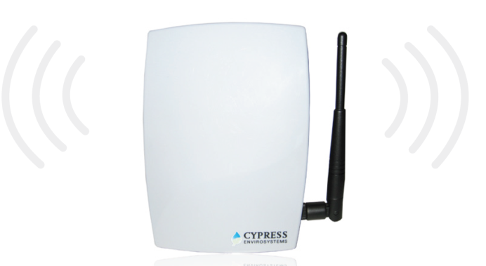
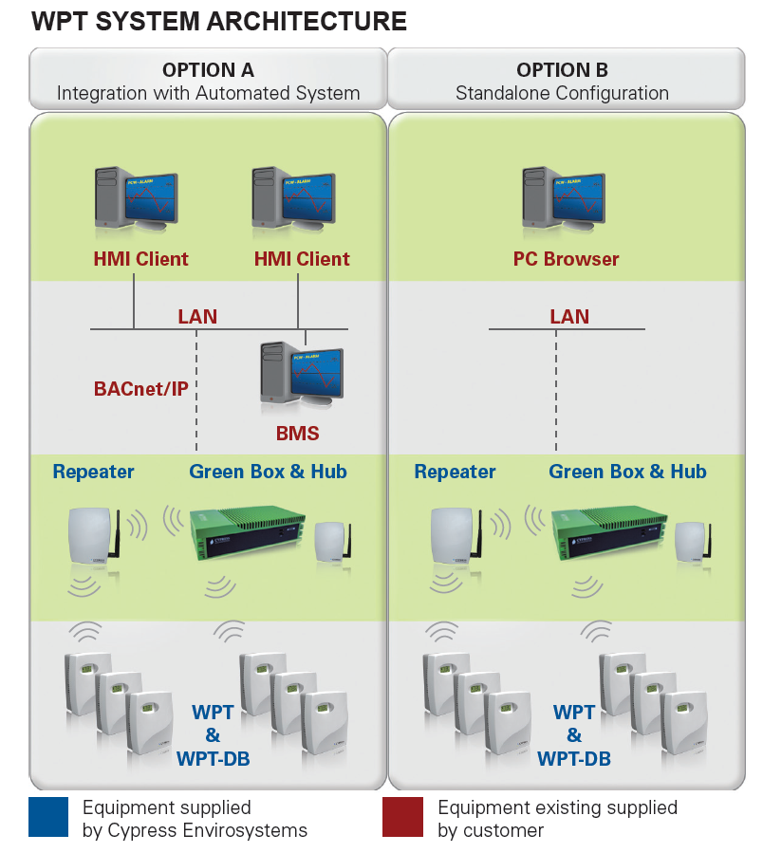
WIRELESS REPEATER
(WPT-810-RPT)
FEATURES:
Extends range of Wireless Pneumatic Thermostat (WPT)
One repeater can accommodate up to 15 WPT’s
One Hub (HUSB) can accommodate up to 14 repeaters
Universal mounting bracket allows for easy installation anywhere
Extends the wireless signal coverage for a Wireless Pneumatic Thermostat (WPT) network
The patented Wireless Pneumatic Thermostat (WPT) delivers DDC functionality at a fraction of the time and cost without the need to change out pneumatic pipes, run wires, replace actuators or disturb occupants.
The WPT enables remote monitoring of zone temperature, branch pressure, remote control of setpoints, and programmable setback or setup of the pneumatic HVAC systems. It also enables integration with utility Demand Response programs.
The Wireless Repeater is used to extend the wireless range or coverage of the WPT network. When the USB Hub (HUSB) is located out of radio frequency range of the repeater, multiple repeaters can be used to extend the range.
PBRPT201705

Slide 2
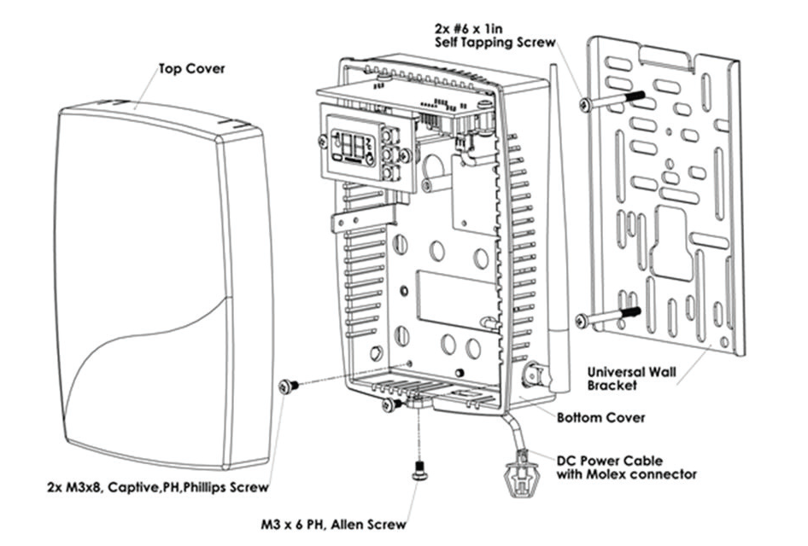
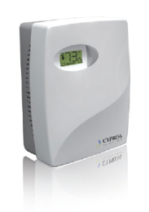
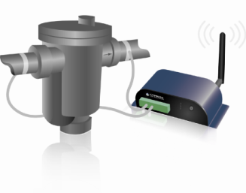
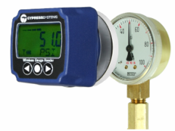
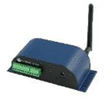
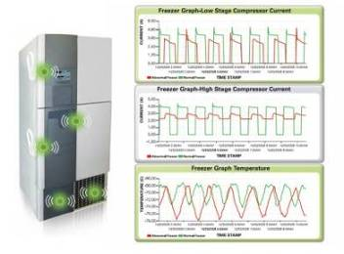
KEY PRODUCT SPECIFICATIONS:
Power:
Antenna:
Operating Frequency:
Operating Condition:
Storage Condition:
Product Weight:
Dimensions:
3.3V DC; 3W (powered by DC adaptor)
External rubber dipole, 4dBi gain, omni-directional, 2.4 to 2.5 GHz
2.4 GHz ISM Band
32°F to 122°F (0°C to 50 °C); 95% RH Maximum, Non-condensing
-40°F to 122°F (-40°C to 50 °C); 95% RH Maximum, Non-condensing
15.8 oz (448 g)
Length: 5.6 in (141 mm) Width (with antenna): 5.6 in (141 mm) Depth: 2.1 in (53.3 mm)
OUR FAMILY OF PRODUCTS:
WIRELESS PNEUMATIC
THERMOSTAT (WPT)
WIRELESS STEAM TRAP
MONITOR (WSTM)
WIRELESS GAUGE
READER (WGR)
WIRELESS TRANSDUCER
READER (WTR)
WIRELESS FREEZER
MONITOR (WFM)
HEADQUARTERS
5883 Rue Ferrari, Suite 100
San Jose, CA 95138
+1 800 544-5411
www.CypressEnvirosystems.com
info@CypressEnvirosystems.com
Cypress Envirosystems and its logo are trademarks of Cypress Envirosystems, Inc. The name of any other company, products, or services mentioned herein are for identification purposes only and may be trademarks or service marks of or may be copyrighted by their respective holders.
Copyright 2017 Cypress Envirosystems, Inc. All rights reserved.
PBRPT201705

