Slide 1
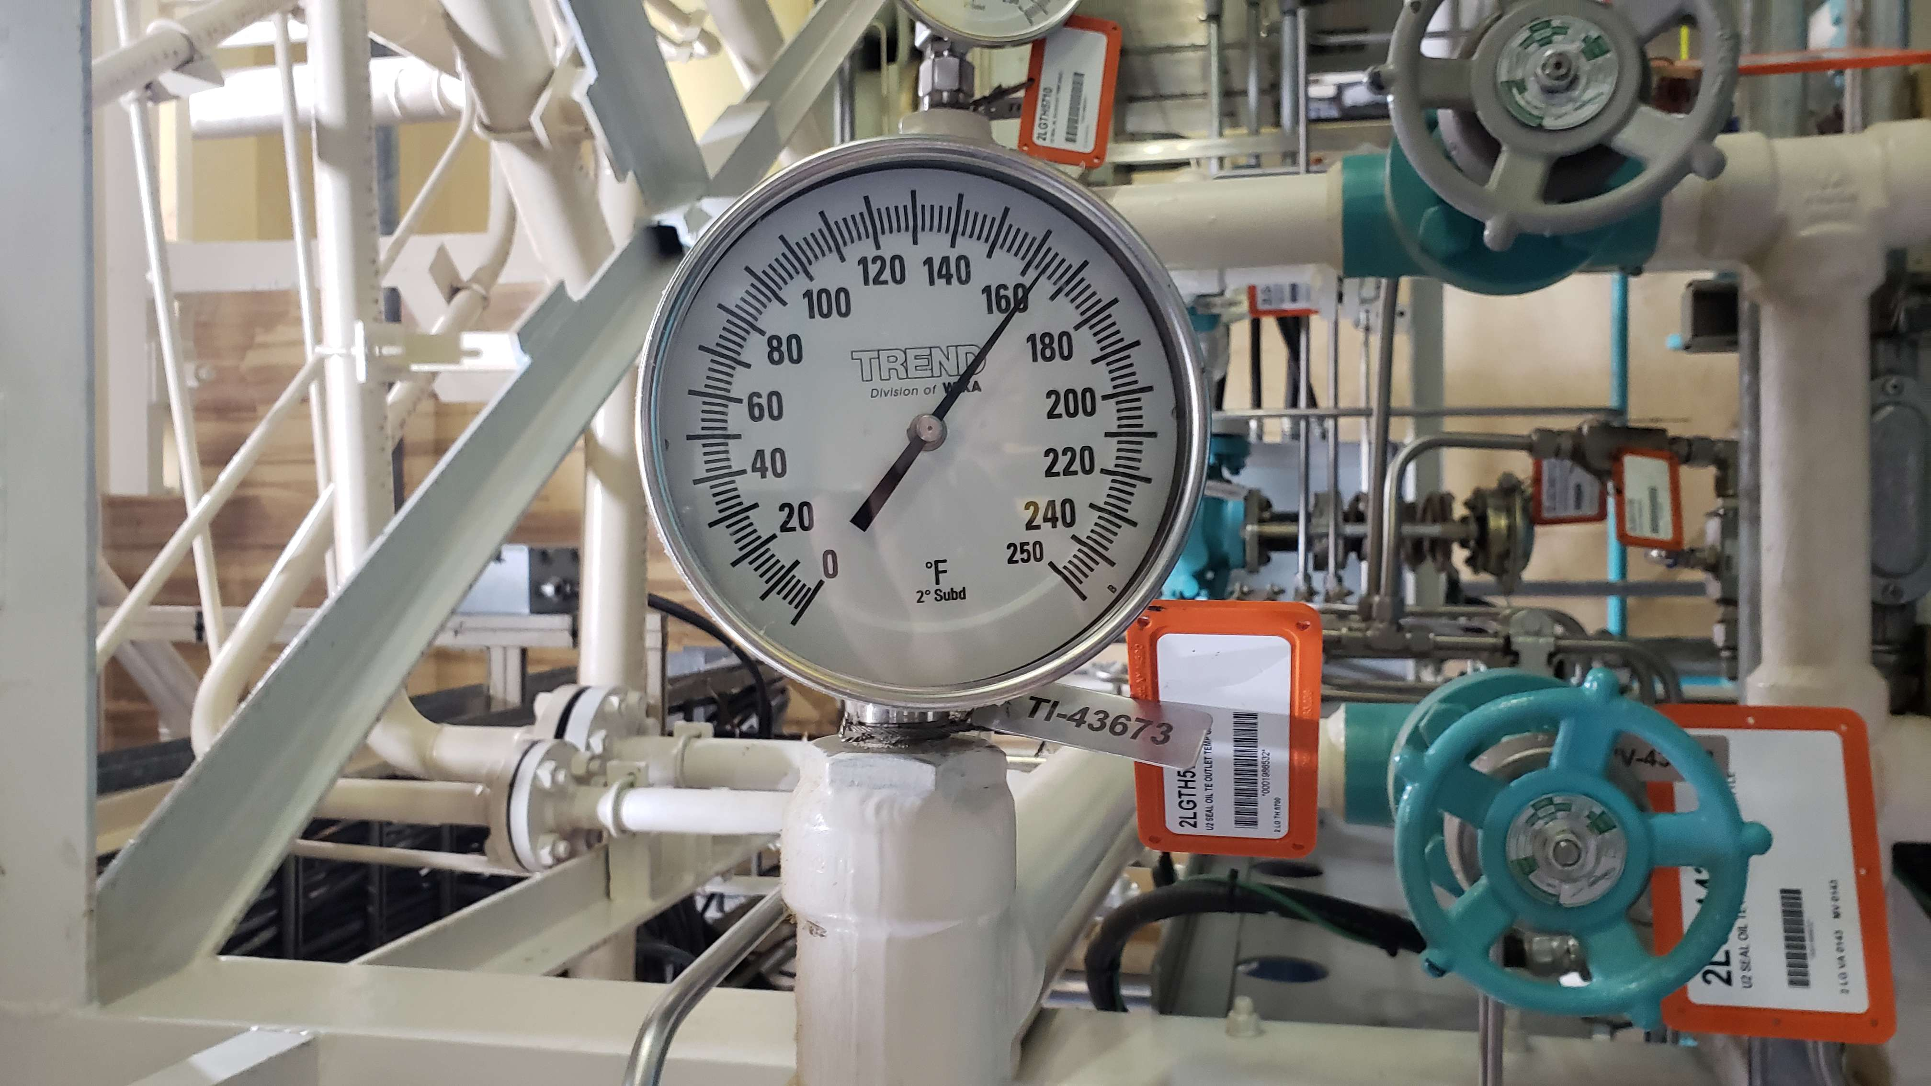


Slide 2
Does your plant look like this?

Slide 3
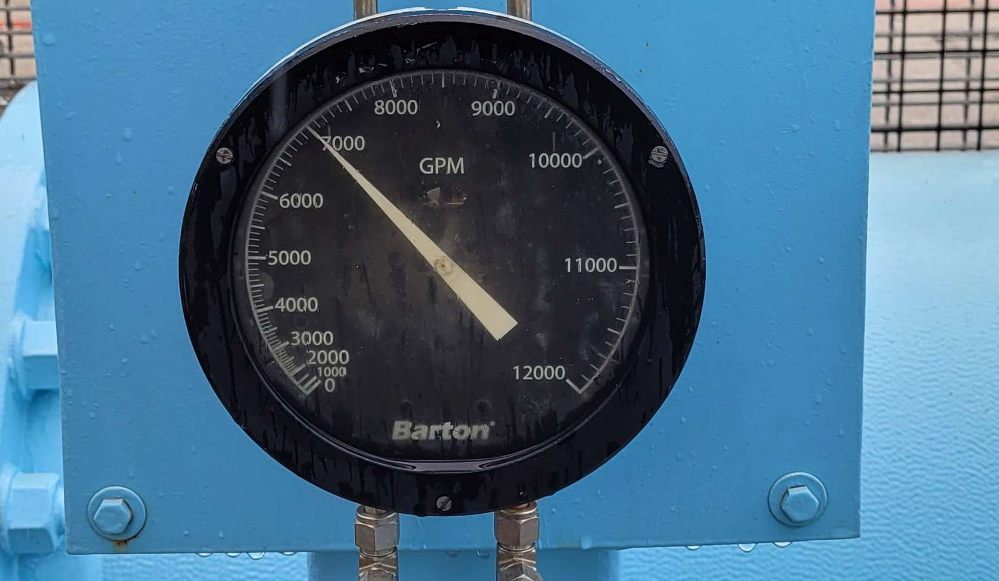
Does your plant look like this?

Slide 4
Does your plant look like this?

Slide 5


Slide 6
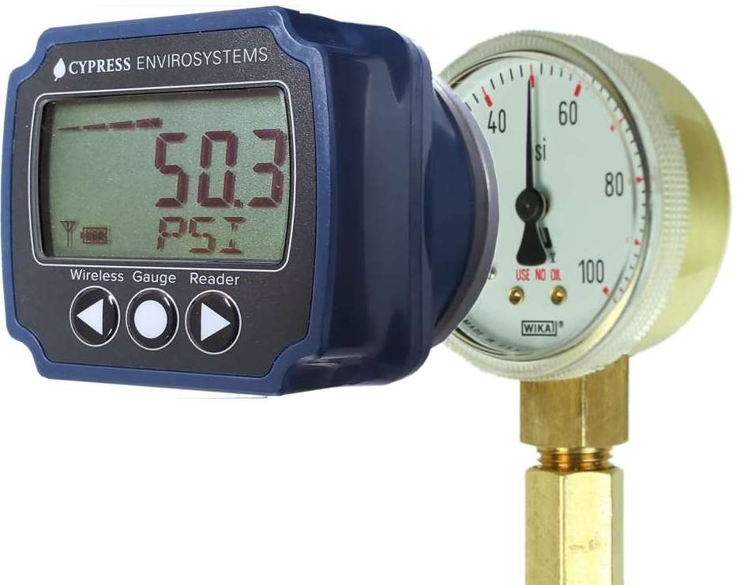
Introducing the Wireless Gauge Reader

Slide 7
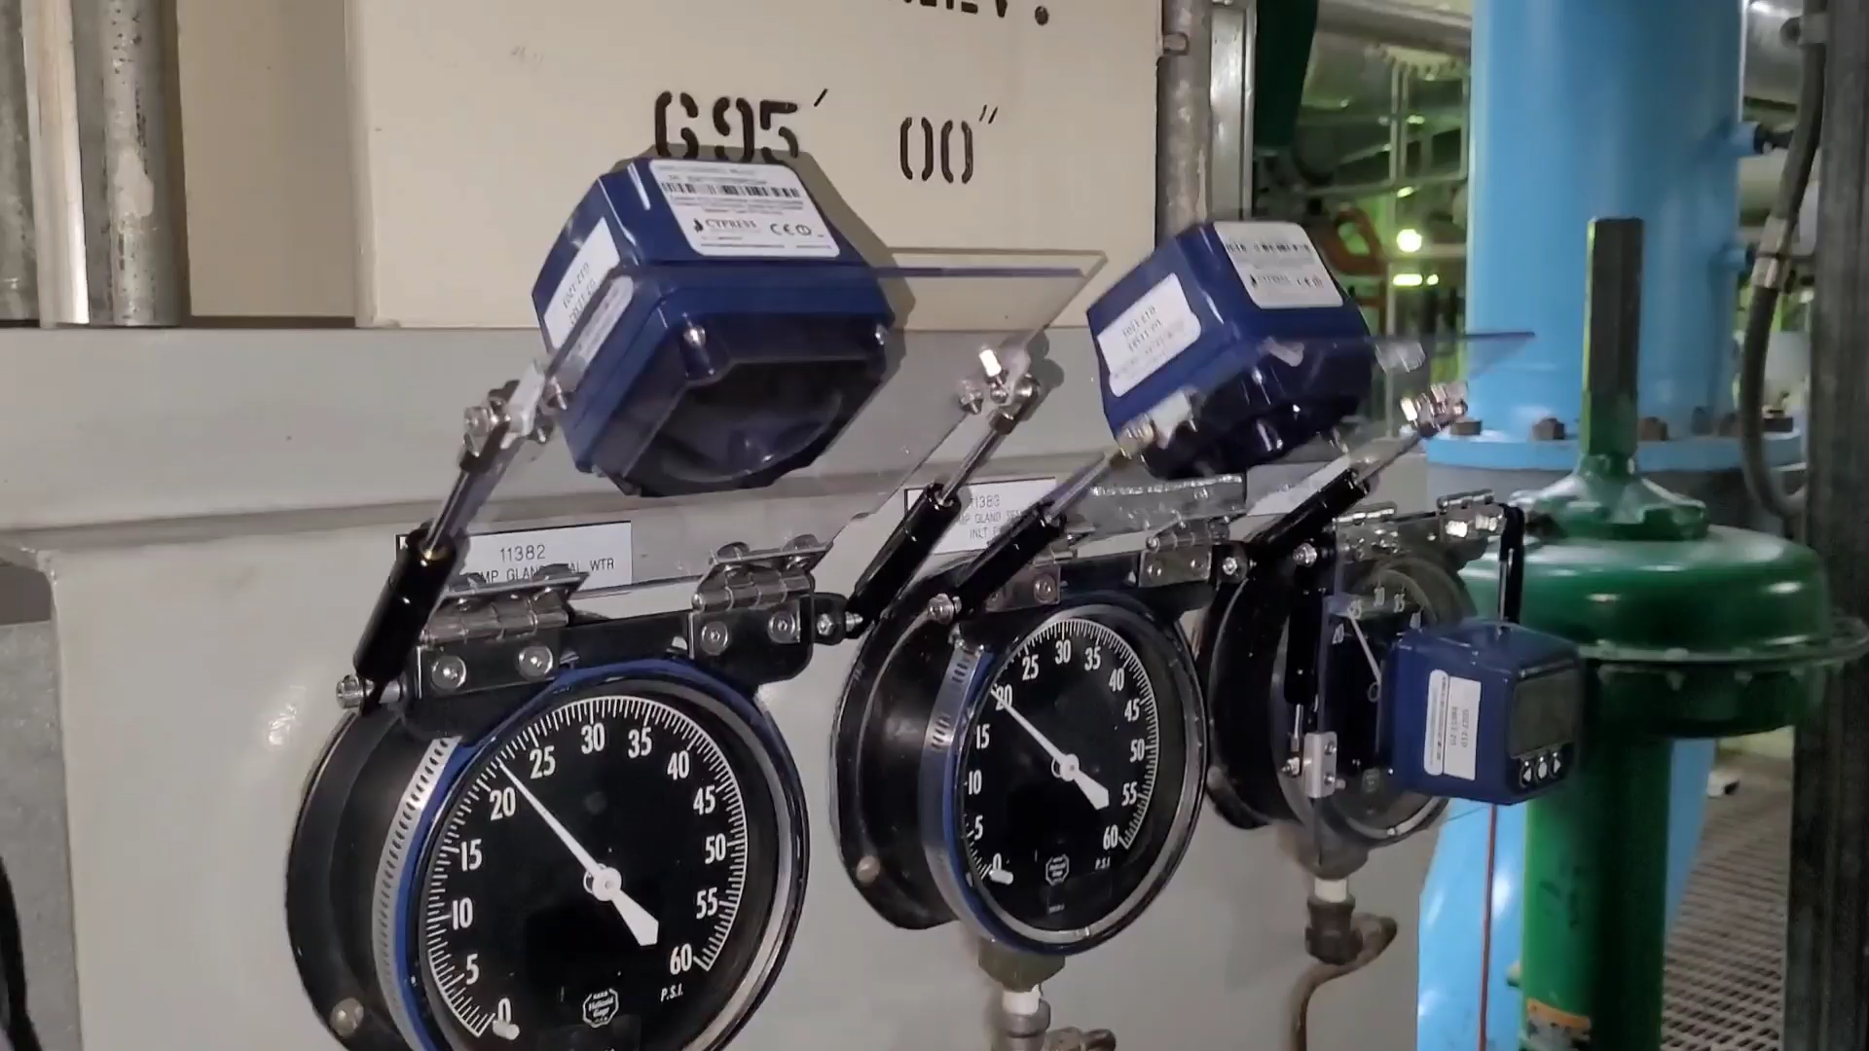

Slide 8
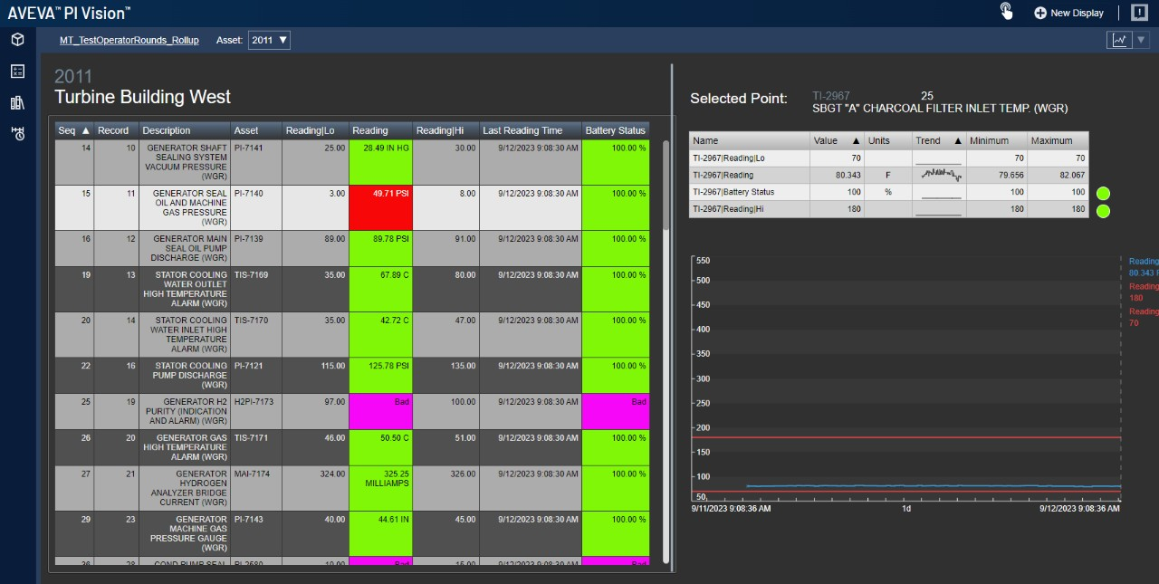
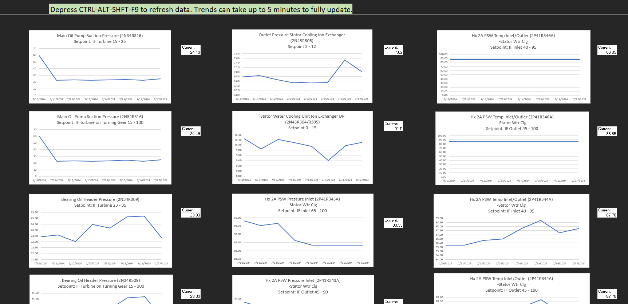
Data Seamlessly Shared with PI Historian and Plant Network

Slide 9
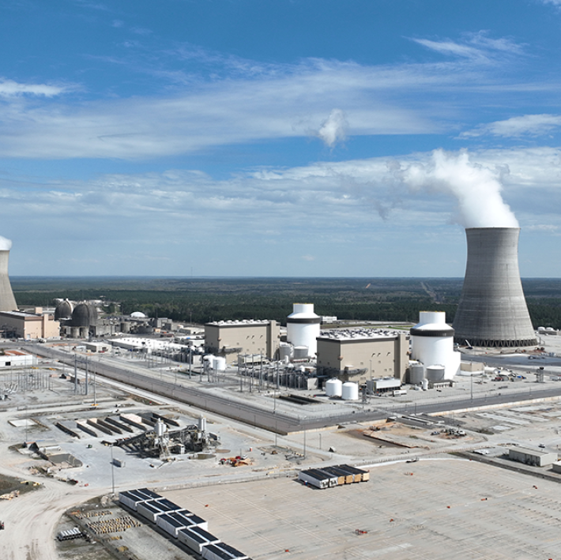

Installed at 33 Nuclear Plants in North America
Non-Invasive
Install in minutes
Wireless, battery > 3 years
Cybersecurity approved
RCA, Seismic structures

Slide 10
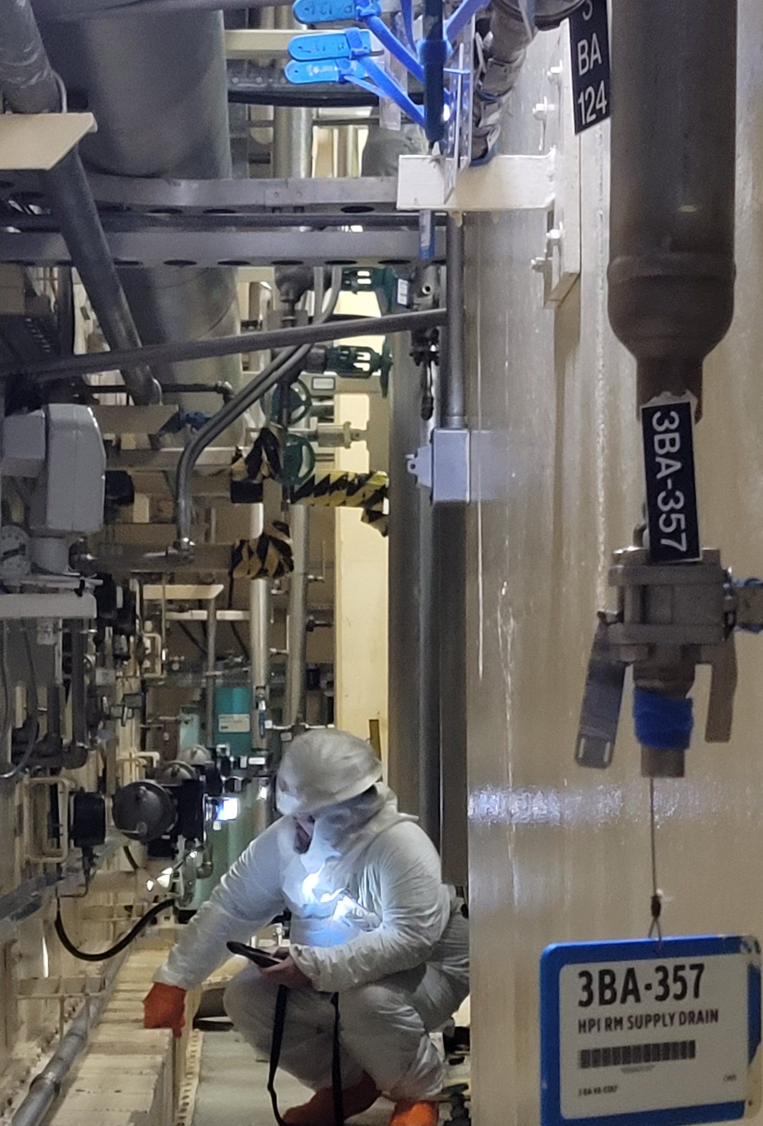
Condition Based Maintenance
Troubleshooting
Operator efficiency
Thermal Performance
Safety / Radiation Dose Reduction

Slide 11




Winner
2024 IAEA
Innovation Prize

Slide 12

www.CypressEnvirosystems.com

